Slide 1
Characteristics of Life
Respiration – make energy (ATP,Mitochondria)
Reproduction- pass on hereditary information.
Repair and Growth- increase in size and number.
Regulation-Nervous/Endocrine Systems (control and coordination)
Transport-Circulatory System (absorption, circulation)
Excretion- removal of cellular wastes (water, CO2)
Nutrition- obtaining food for growth and repair of cells
Synthesis- making something complex out of something simple (building molecules)

Slide 2
Metabolism & Homeostasis
Metabolism is the combination of all the chemical reactions that occur in an organism.
Through chemical reactions… organisms maintain a stable internal environment. This is Homeostasis.

Slide 3
All living things are made of cells
Cells are the basic unit of structure and function of all organisms.
Cells come from pre-existing cells.
All cells are surrounded by a thin membrane, that controls the movement of materials in and out of the cell (cell membrane).

Slide 4
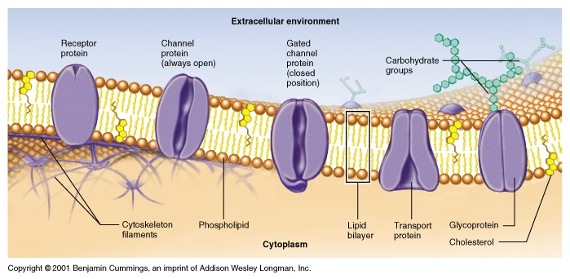
The Cell Membrane
All cells are surrounded by a thin membrane, that controls the transport of materials in and out of the cell. This helps maintain homeostasis.

Slide 5
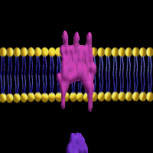
Receptor Molecules
Certain protein molecules in the cell membrane can receive chemical messages from other cells.
Chemical messages can be in the form of Hormones from the Endocrine System, or chemicals from the Nervous System.

Slide 6
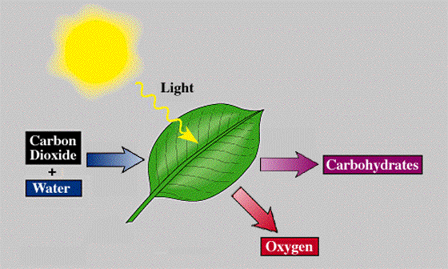
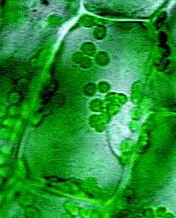
Photosynthesis
Plants absorb carbon dioxide from the air. Too much carbon dioxide will cause the Earth to heat up
(the greenhouse effect).
chloroplasts
Animals can eat the sugar made to use as energy
Energy rich organic compounds.
All animal life on Earth (including humans) depends on the oxygen produced by photosynthesis!

Slide 7

Cellular Respiration
Glucose(sugar) is used to produce high energy storage molecules know as ATP.
Energy is stored in the bonds of the ATP molecule. This is the energy source for all life processes.
Water
Oxygen from the environment.
Carbon Dioxide
Glucose
Energy (ATP)
Mitochondria
Respiration occurs continuously in the cells of all organisms.

Slide 8
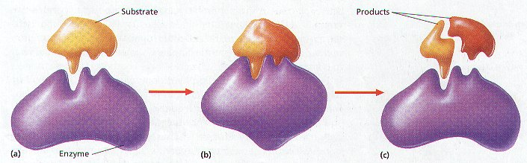
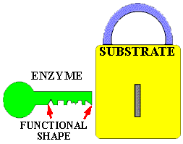
Enzymes
• Proteins that affect the rate of chemical reactions in all organisms.
• As with many other molecules, enzymes have a specific shape. This enables them to react with specific molecules.

Slide 9
Enzyme Function
The rate at which an can function is affected by…..
Temperature:
Human enzymes function best at 98.6 degrees Fahrenheit.
THAT’S 37 degrees CELSIUS!!!!!!!!!!!
pH:
Human enzymes function best at a pH of 7

Slide 10

Immune System
The body’s primary defense against disease-causing pathogens.
Foreign invaders are identified by molecules on their outer surfaces or membranes. These molecules are called antigens.
Special white blood cells make antibodies, that mark the invader for future killing by other cells.
Bacteria
Antigens

Slide 11
Diseases:
Failure of Homeostasis
Disease: A condition that prevents the body
from working normally.
Causes: Foreign invaders such as bacteria and viruses. (Pathogens)
Even organ transplants
Abnormal cells in the body. (Cancer)
Poor nutrition
Toxic substances
Inherited disorders

Slide 12
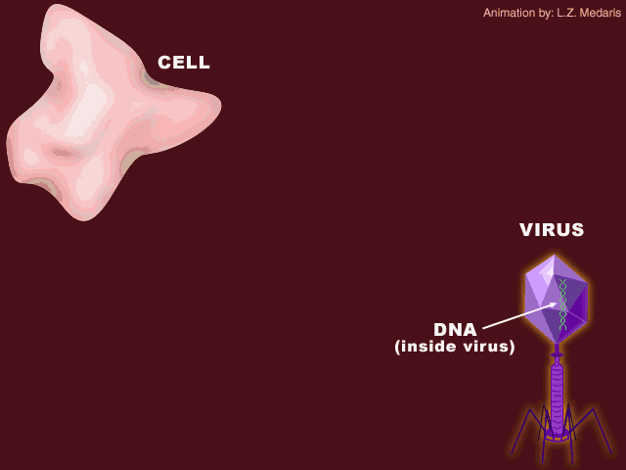
Virus attacking a host cell

Slide 13
Genetics
**The branch of Biology that studies heredity
Heredity:
From the Latin word hered-, meaning “heir”. Heredity describes the genetic information that is passed from one generation to the next.

Slide 14
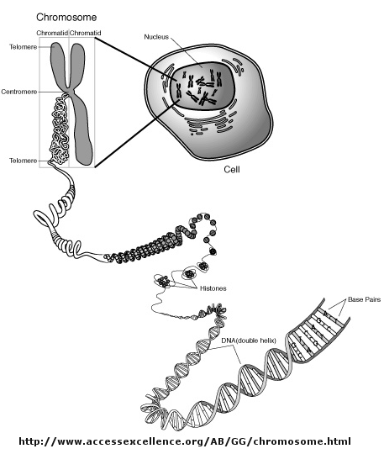
As you know, chromosomes are contained in the nucleus of every eukaryotic cell.
Chromosomes carry the genetic information that is passed from generation to generation.
Chromosomes are made of protein (Histones) & DNA.
Histones are proteins that act as spools for the DNA.

Slide 15
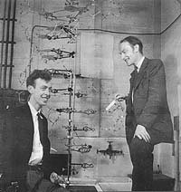
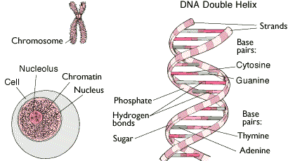
In 1953 Watson and Crick determined the molecular structure of DNA, that lead to the explanations of how it can replicate, code for protein, and mutate allowing species to have variations on which natural selection can act.

Slide 16
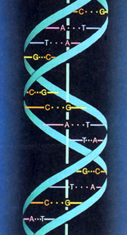

The Structure of DNA
Two chains of of nucleotides are connected together at the bases by hydrogen bonds.
The structure of DNA is called a double helix. It looks like a twisted ladder.

Slide 17
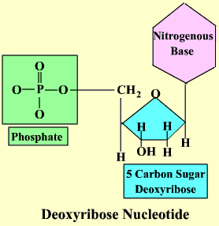
The subunits of DNA are nucleotides
A nucleotide is made of a phosphate,
a 5 carbon sugar and a nitrogenous base.

Slide 18
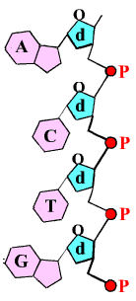
This is a chain of 4 nucleotides.
The d stands for the sugar, deoxyribose, the P for phosphate and A, C, T and G for the nitrogenous bases, adenine, cytosine thymine and guanine.
Note that the backbone of this strand is composed of alternating sugar and phosphate molecules, held together by WEAK HYDROGEN BONDS.
Covalent Bonds

Slide 19
DNA
deoxyribonucleic acid
Found in the nucleus of cells.
Stores genetic information
Contains the complete instructions for manufacturing all the proteins of an organism.

Slide 20
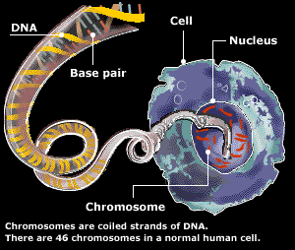
All living things contain DNA.
There are 46 chromosomes
in one human body cell.
There are 23 chromosomes in a human sex cell/ gamete.

Slide 21
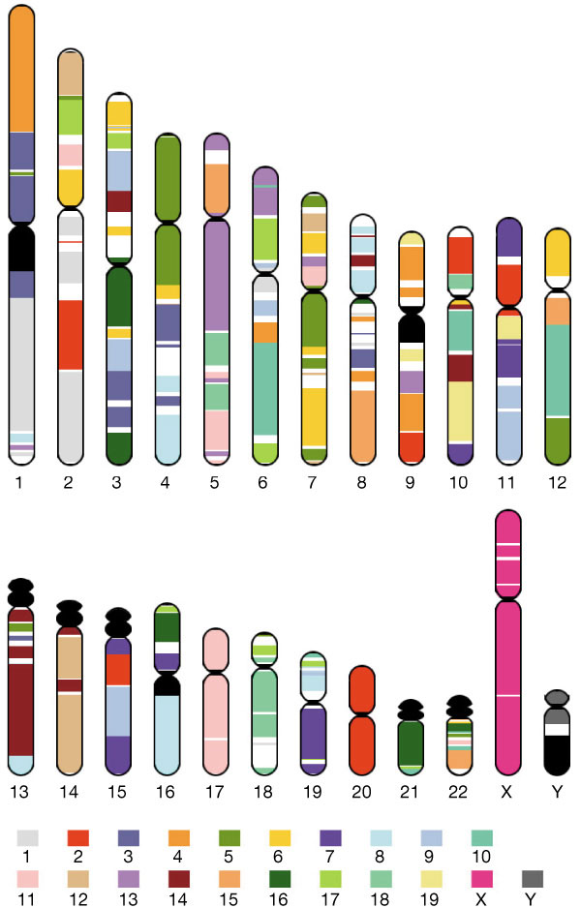
The hereditary information (DNA) is organized in the form of genes located in the chromosomes of each cell.
The human Genome is thought to consist of approximately 60,000 genes, spread out over 46 chromosomes. This question is still being worked on.

Slide 22



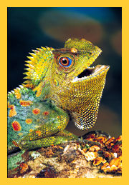
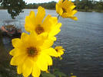
The Genetic Code is Universal.
The same nucleotides exist in every organism, just in a different order (SEQUENCE).

Slide 23


The closer the order of the base sequence between organisms, the closer the organisms are related in terms of evolution.
Having a common ancestor.

Slide 24
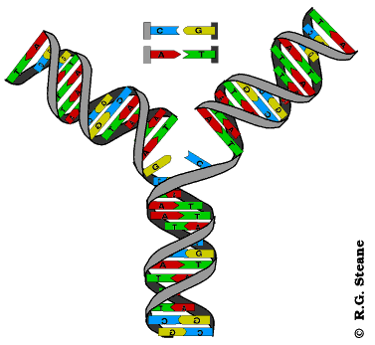
DNA Replication
Nucleotides floating free in the nucleus are bonded to the nucleotides on the original strand.

Slide 25
RNA
ribonucleic acid
Translate the information in DNA to the instructions for making protein.
Actually manufactures protein (ribosomes)

Slide 26
Comparing RNA and DNA
RNA
DNA
Single Strand of nucleotides Double strand of nucleotides
The sugar is ribose The sugar is deoxyribose
Bases: Bases:
Guanine Guanine
Cytosine Cytosine
Adenine Adenine
Uracil Thymine
Function: Function:
The workers for protein synthesis. Provides the instructions for
making the proteins that make up
living things.

Slide 27
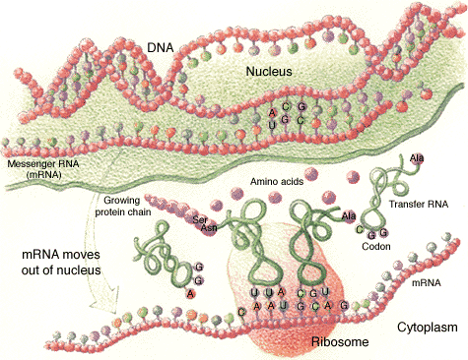
Protein Synthesis

Slide 28

Ecology
The study of organisms and their interactions
with the environment.

Slide 29
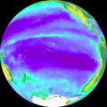
The Biosphere
The region of the Earth that supports all life.
Consists of :
  Air- the atmosphere (troposphere, stratosphere)
  Water- 75% of our Planet
  Land- soil, ground, sand, rocks

Slide 30

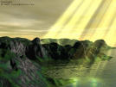
Biotic Factors:
The living part of the environment.
Any plant, animal, fungus bacteria & protist.
Remember: The prefix Bio, means living.
Not
Abiotic Factors:
The non-living parts of the environment.
Water, soil, light, energy and
living space, weather, wind,
pollution.

Slide 31
The Levels of Organization in Ecology
Biosphere:
Ecosystem:
Community:
Population:
Organism:
Habitat:
All ecosystems, from the deepest ocean trenches to the highest mountain tops and even the sky.
The community and the physical environment.
Many populations that interact with each other in one area.
All the organisms of one species, in one area, at one time.
A living thing.
A specific environment for a species.(Their home)

Slide 32
Relationships in an Ecosystem
The Relationships between organisms can be competitive or beneficial.
I. Competition: Two or more organisms strive for
the same limited resources
II. Symbiosis: A relationship between 2 organisms
where at least one benefits.

Slide 33


The 3 types of Symbiosis are:
A. Mutualism: Both species benefit.
Examples: bees & flowers
Legumes and Nitrogen fixing bacteria
Termites & Protozoa

Slide 34
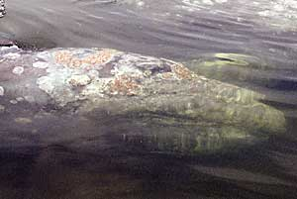

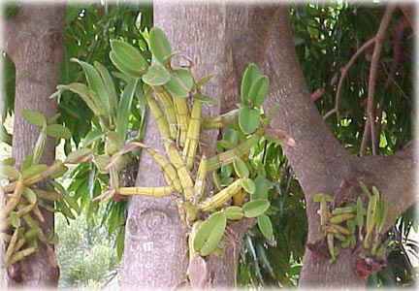
B. Commensalism: One organism benefits while
the other is unaffected.
Dust mites in your eyebrows
Orchids grow on trees
Barnacles on whales
Bacteria in your intestines.

Slide 35
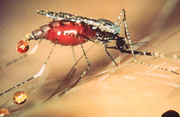
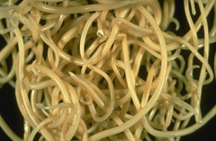
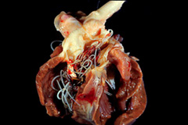
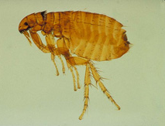
C. Parasitism: The parasite benefits while the host
is harmed. (diseases)
Heart worms.
Fleas
Feed on blood

Slide 36
Predation:
One organism kills and eats another.
Predator: Kills and eats another
organism for food.
Prey: Is killed and eaten, “the food”
This is a form of natural selection.
The weaker or diseased organisms get captured, leaving behind the healthy one to reproduce. Predation may also control overpopulation.

Slide 37
How Man Interacts With the Environment
There are 6.5 billion people on Earth.
This number grows exponentially.
This large number of people causes most of the problems on Earth.
Limiting factors: food, water, shelter, space.( These will keep numbers from growing- causes competition if limited resources).

Slide 38
Pollution
Water: wastes and chemical deposited into our water system, rivers, oceans, lakes.
Air: caused by burning fossil fuels, depletes the ozone layer, causes acid rain.
Land: dumping of solid wastes. Landfills- no space left, incinerators cause air pollution.

Slide 39
Controlling Pollution
Control car emissions- pass tougher laws, give higher fines.
Sewage control- pass tougher laws, give higher fines.
Recycle- reduce, reuse, recycle
Soil conservation- stop deforestation, crop rotation, cover crops.
AVOID PESTICIDES!!!!!

Slide 40
Major Environmental Issues
Global Warming- burning of the fossil fuels leads to Greenhouse Effect.
Deforestation- cutting down the rainforest, loss of O2.
Loss of Habitat- causes animals to become endangered.
Endangered Species- leads to extinction if not controlled.
Misuse of Renewable and Non-Renewable Resources- lack of oil has lead to a renewed interest in finding alternative methods of energy.

Slide 41

Resources
Renewable Resources- are readily available, they are always going to be present. (Examples- sunlight, water, wind)
Non-Renewable Resources- can’t be replaced once they have been depleted or used up. (Examples- fossil fuels, natural gas,forests)

Slide 42
Resources for Studying
www.nysedregents.org/LivingEnvironment
www.regentsreviewlive.net
You tube Mr. Gonzales LE review
Study packets- Last years test, Part C review, Diagram packet, Part D lab review

