Slide 1
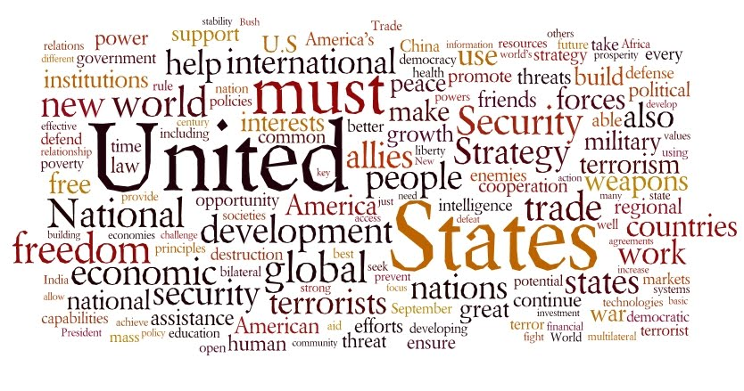
Chapter 20: National Security Policymaking

Slide 2
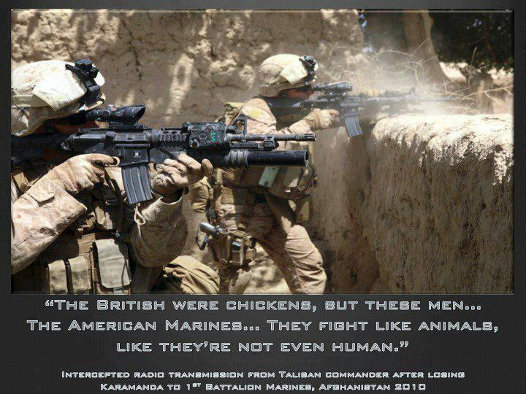
Foreign Policy Instruments
Military: War & the threat of war

Slide 3
Economic Trade & tariff policies, monetary policies

Slide 4
Diplomatic Process by which nations carry on relationships with each other

Slide 5
Actors in Foreign Relations
International Organizations
UN, OPEC
Regional Organizations
NATO, EU, NAFTA, SEATO
Multinational Corporations
Coca-Cola, McDonald’s, Marriot, Google, Microsoft
Nongovernmental Organizations
Amnesty International, Greenpeace, Red Cross, Doctors without Borders
Individuals
Tourists, Immigrants, Refugees
Terrorists
Al Qaeda, Drug Cartels

Slide 6
Policymakers
President
Commander-in-Chief, Chief Diplomat (appoints ambassadors, dep’t. heads, negotiates treaties, executive orders, recognition)
Diplomats
Sec’y of State
National Security Establishment
Sec’y of Defense & Dep’t. of Defense
Joint Chiefs of Staff: commanding officers of each branch of service
National Security Council: diplomatic & military
CIA: coordinates intelligence activities
Congress: authority over foreign & defense policy
Advice & consent, “power of the purse”

Slide 7
U.S. Foreign Policy
1789-1945: Isolationism
Monroe Doctrine & Roosevelt Corollary
WWI & WWII
1945-1991: Interventionism & Containment
UN; Peacekeeping Operations (’45-present)
Cold War: Arms Race, proxy wars
Détente: 1970s
Reagan Rearmament: 1980s
11 Sept 2001-present: “War on Terror(ism)”
Iraq, Afghanistan

Slide 8
Military Policy
Military Expenditures
Personnel
Weapons

Slide 13
Oops, sorry … that’s China. Yes. China.

