Slide 1
Chapter 2
Environmental Systems
Friedland and Relyea Environmental Science for AP®, second edition ©2015 W.H. Freeman and Company/BFW
AP® is a trademark registered and/or owned by the College Board®, which was not involved in the production of, and does not endorse, this product.

Slide 2
Module 4 Systems and Matter
After reading this module you should be able to
describe how matter comprises atoms and molecules that move among different systems.
explain why water is an important component of most environmental systems.
discuss how matter is conserved in chemical and biological systems.

Slide 3
Matter comprises atoms and molecules that move among different systems
Matter Anything that occupies space and has mass.
Mass A measurement of the amount of matter an object contains.

Slide 4
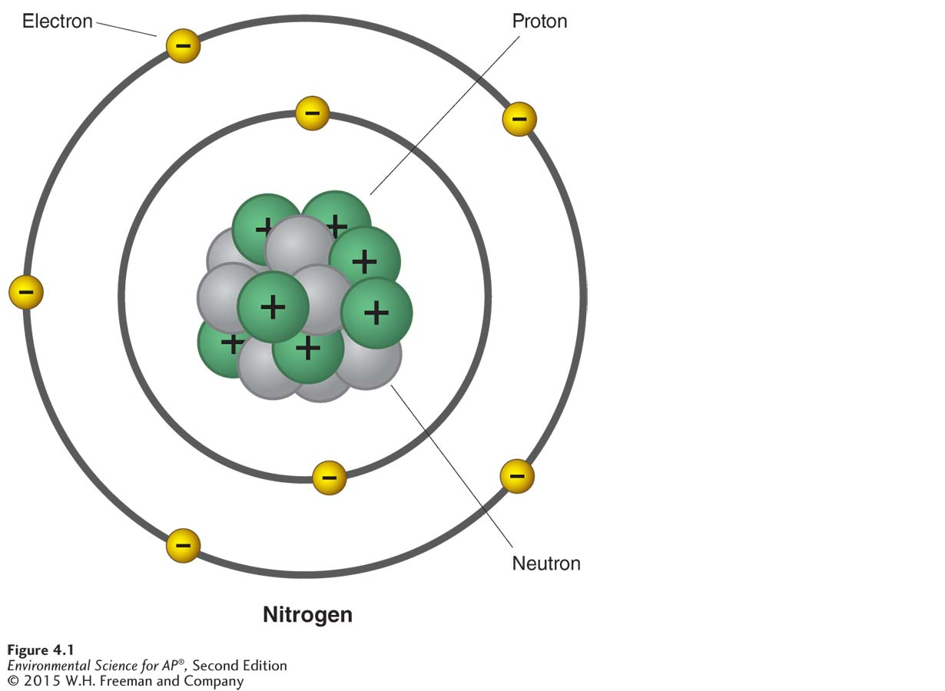
Atoms and Molecules
Atom The smallest particle that can contain the chemical properties of an element.
Element A substance composed of atoms that cannot be broken down into smaller, simpler components.
Structure of the atom.
An atom is composed of protons, neutrons, and electrons. Neutrons and positively charged protons make up the nucleus. Negatively charged electrons surround the nucleus.

Slide 5
Atoms and Molecules
Periodic table A chart of all chemical elements currently known, organized by their properties.
Molecule A particle that contains more than one atom.
Compound A molecule containing more than one element.
Atomic number The number of protons in the nucleus of a particular element.
Mass number A measurement of the total number of protons and neutrons in an element.
Isotopes Atoms of the same element with different numbers of neutrons.

Slide 6
Radioactivity
Radioactive decay The spontaneous release of material from the nucleus of radioactive isotopes.
Half-life The time it takes for one-half of an original radioactive parent atom to decay.
Covalent bond The bond formed when elements share electrons.

Slide 7
Chemical Bonds
There are three types of chemical bonds:
covalent bonds
ionic bonds
hydrogen bonds

Slide 8
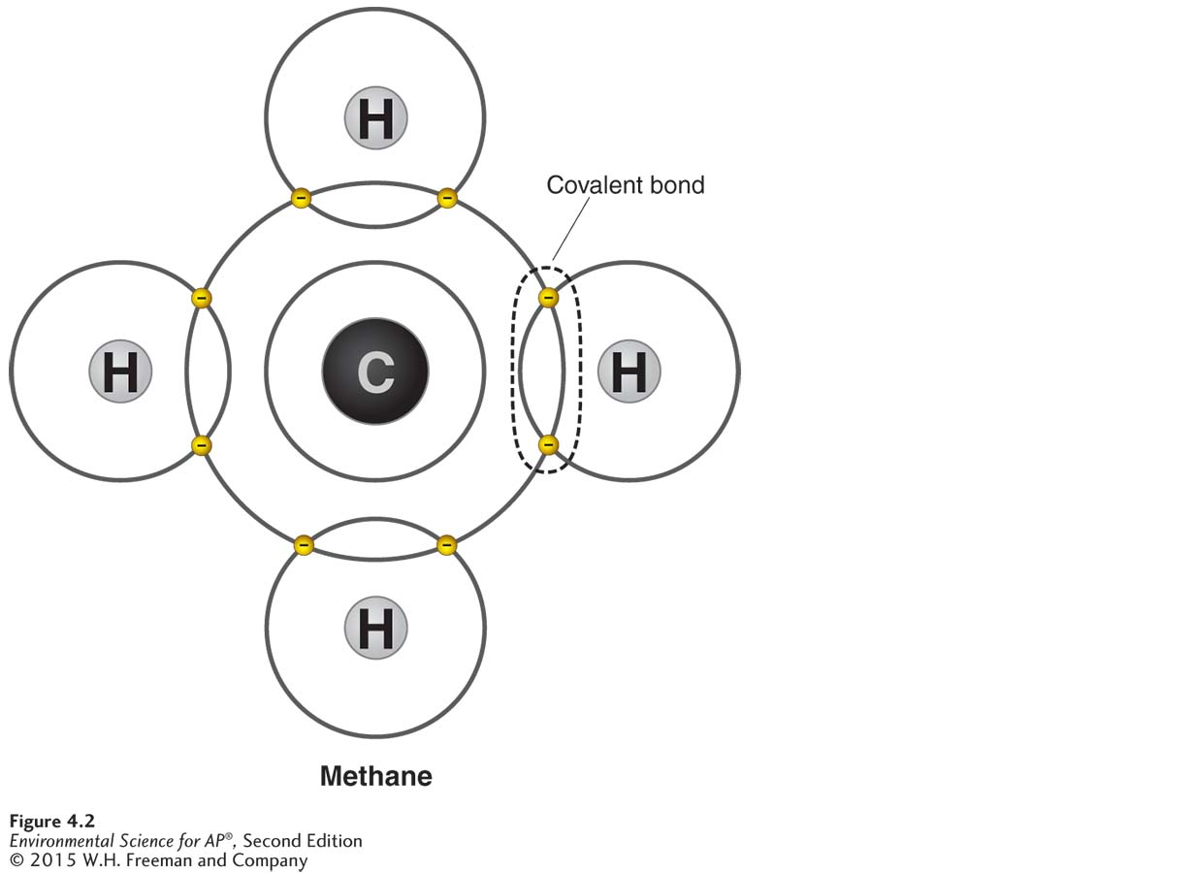
Covalent Bonds
Covalent bond The bond formed when elements share electrons.
Covalent bonds. Molecules such as methane (CH₄ ) are associations of atoms held together by covalent bonds. As a result of the four hydrogen atoms sharing electrons with a carbon atom, each atom has a complete set of electrons in its outer shell—two for the hydrogen atoms and eight for the carbon atom.

Slide 9
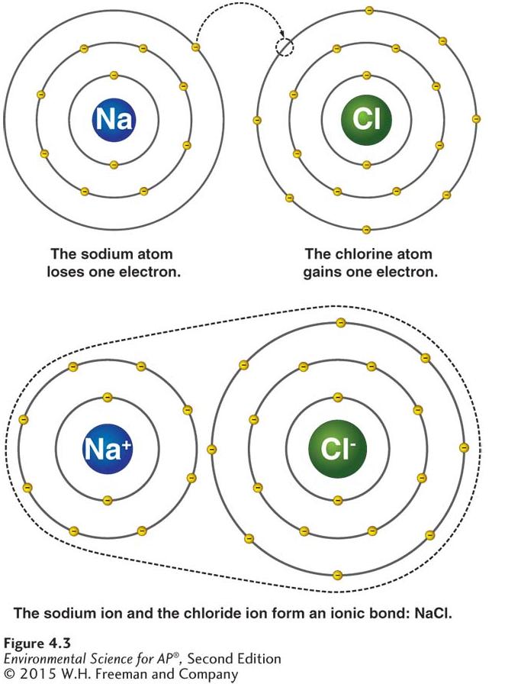
Ionic Bonds
Ionic bond A chemical bond between two ions of opposite charges.
Ionic bonds. To form an ionic bond, the sodium atom loses an electron and the chlorine atom gains one. As a result, the sodium atom becomes a positively charged ion (Na+) and the chlorine atom becomes a negatively charged ion (Cl−, known as chloride). The attraction between ions of opposite charges—an ionic bond—forms sodium chloride (NaCl), or table salt.

Slide 10
Hydrogen Bonds
Hydrogen bond A weak chemical bond that forms when hydrogen atoms that are covalently bonded to one atom are attracted to another atom on another molecule.
Polar molecule A molecule in which one side is more positive and the other side is more negative.

Slide 11
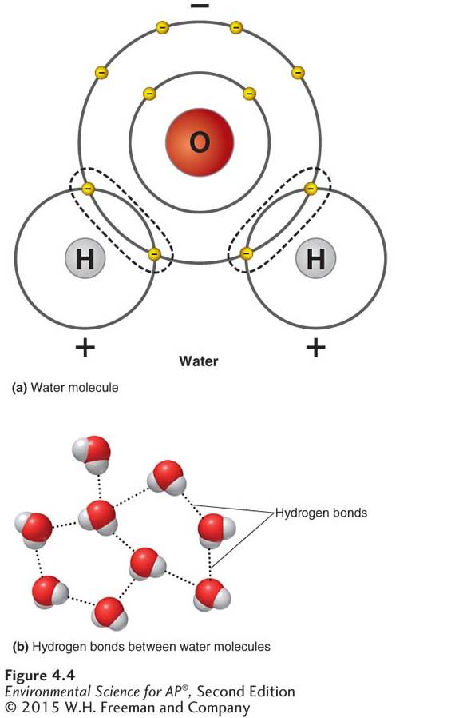
Hydrogen Bonds
The polarity of the water molecule. (a) Water (H₂O) consists of two hydrogen atoms covalently bonded to one oxygen atom. Water is a polar molecule because its shared electrons spend more time near the oxygen atom than near the hydrogen atoms. The hydrogen atoms thus have a slightly positive charge, and the oxygen atom has a slightly negative charge. (b) The slightly positive hydrogen atoms are attracted to the slightly negative oxygen atom of another water molecule. The result is a hydrogen bond between the two
molecules.

Slide 12
Water is a vital component of most environmental systems
Water has many significant properties.

Slide 13
Properties of Water
Surface tension A property of water that results from the cohesion of water molecules at the surface of a body of water and that creates a sort of skin on the water’s surface.
Capillary action A property of water that occurs when adhesion of water molecules to a surface is stronger than cohesion between the molecules.
At Earth’s surface, water boils at 100 degrees Celsius and freezes at 0 degrees Celsius.
Many substances dissolve well in water because their polar molecules bond easily with other polar molecules.

Slide 14
Acids, Bases, and pH
Acid A substance that contributes hydrogen ions to a solution.
Base A substance that contributes hydroxide ions to a solution.
pH The number that indicates the relative strength of acids and bases in a substance.

Slide 15
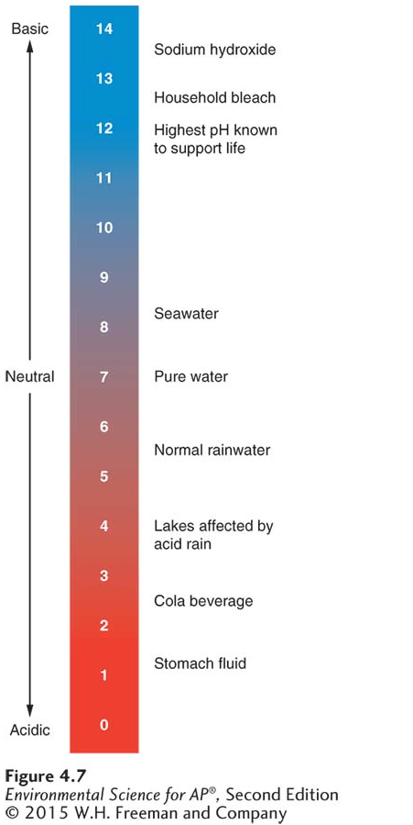
Acids, Bases, and pH
The pH scale. The pH scale shows how acidic or how basic a solution is.
The pH scale ranges from 0-14.
A pH value of 7 is neutral.
A pH value above 7 is basic.
A pH value below 7 is acidic.

Slide 16
Environmental systems contain both chemical and biological reactions
Chemical reaction A reaction that occurs when atoms separate from molecules or recombine with other molecules.
Law of conservation of matter A law of nature stating that matter cannot be created or destroyed; it can only change form.

Slide 17
Biological Molecules and Cells
Inorganic compound A compound that does not contain the element carbon or contains carbon bound to elements other than hydrogen.
Examples: NH₃, NaCl, H₂O, CO₂
Organic compound A compound that contains carbon-carbon and carbon-hydrogen bonds.
Examples: C₆H₁₂O₆, CH₄

Slide 18
Biological Molecules and Cells
Carbohydrate A compound composed of carbon, hydrogen, and oxygen atoms.
Protein A critical component of living organisms made up of a long chain of nitrogen-containing organic molecules known as amino acids.
Nucleic acid Organic compounds found in all living cells.
DNA (deoxyribonucleic acid) A nucleic acid, the genetic material that contains the code for reproducing the components of the next generation, and which organisms pass on to their offspring.
RNA (ribonucleic acid) A nucleic acid that translates the code stored in DNA, which makes possible the synthesis of proteins.
Lipid A smaller organic biological molecule that does not mix with water.

Slide 19
Biological Molecules and Cells
Cell A highly organized living entity that consists of the four types of macromolecules and other substances in a watery solution, surrounded by a membrane
Some organisms are single cell, for example most bacteria.
Other organisms, for example, brine shrimp, are multicellular.

Slide 20
Module 5 Energy, Flows, and Feedbacks
After reading this module you should be able to
distinguish among various forms of energy and understand how they are measured.
discuss the first and second laws of thermodynamics and explain how they influence environmental systems.
explain how scientists keep track of energy and matter inputs, outputs, and changes to environmental systems.

Slide 21
Energy is a fundamental component of environmental systems
Energy The ability to do work or transfer heat.
Joule The amount of energy used when a 1-watt electrical device is turned on for 1 second.
Power The rate at which work is done.

Slide 22
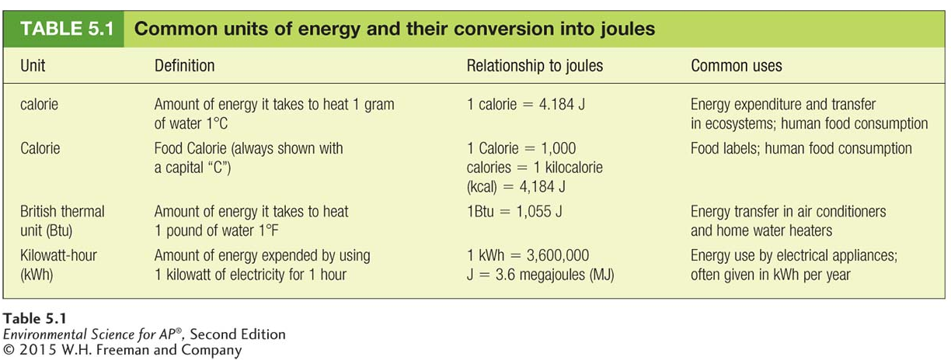
Energy Conversions
energy = power × time
power = energy ÷ time

Slide 23
Forms of Energy
Electromagnetic radiation A form of energy emitted by the Sun that includes, but is not limited to, visible light, ultraviolet light, and infrared energy.
Photon A massless packet of energy that carries electromagnetic radiation at the speed of light.
Potential energy Stored energy that has not been released.
Chemical energy Potential energy stored in chemical bonds.
Kinetic energy The energy of motion.
Temperature The measure of the average kinetic energy of a substance.

Slide 24
The laws of thermodynamics describe how energy behaves
The laws of thermodynamics are among the most significant principles in all of science.

Slide 25
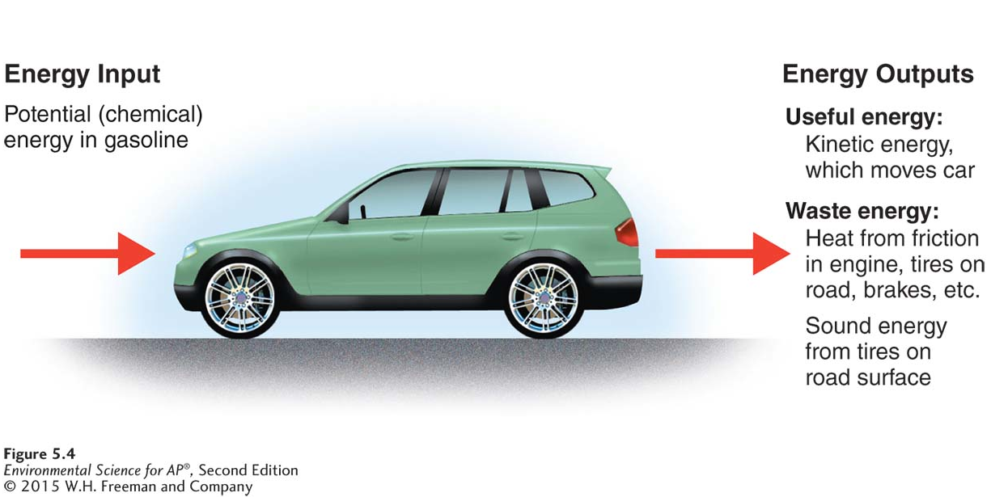
First Law of Thermodynamics
First law of thermodynamics A physical law which states that energy can neither be created nor destroyed but can change from one form to another.
Conservation of energy within a system. In a car, the potential energy of gasoline is converted into other forms of energy. Some of that energy leaves the system, but all of it is conserved.

Slide 26
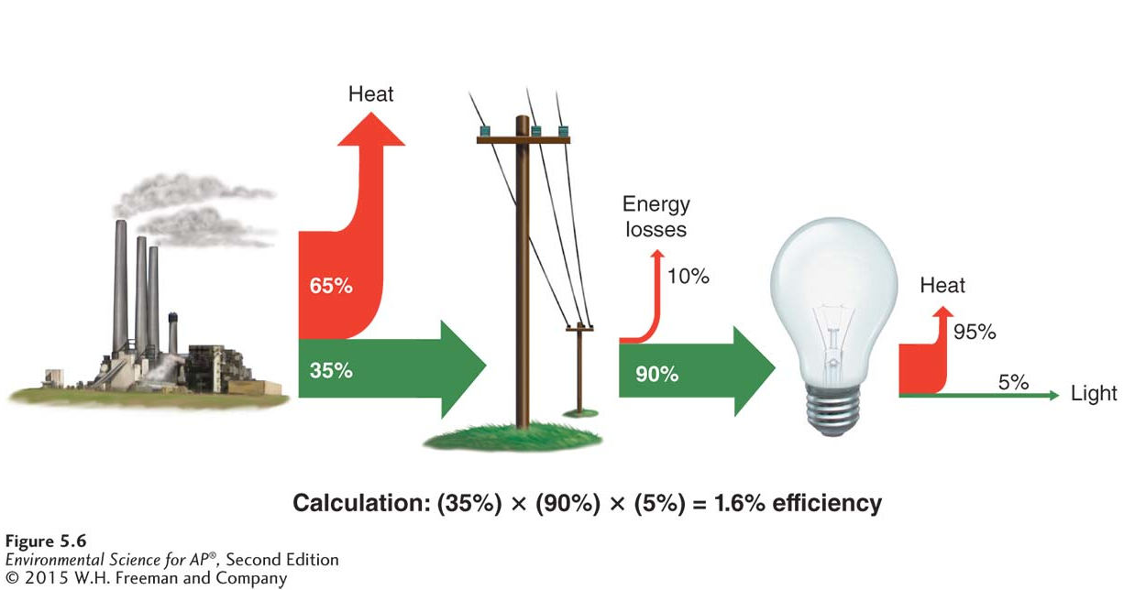
Second Law of Thermodynamics
Second law of thermodynamics The physical law stating that when energy is transformed, the quantity of energy remains the same, but its ability to do work diminishes.
The second law of thermodynamics. Converting coal into the light of an incandescent bulb is only 1.6 percent efficient because energy is lost to heat in the transformation.

Slide 27
Second Law of Thermodynamics
Energy efficiency The ratio of the amount of energy expended in the form you want to the total amount of energy that is introduced into the system.
Energy quality The ease with which an energy source can be used for work.
Entropy Randomness in a system.
Randomness is always increasing in a system, unless new energy from outside the system is added to create order. This should be indented one more level in from the definitions.

Slide 28
Matter and energy flow in the environment
Studying systems allows scientists to think about how energy and matter flow in in the environment.

Slide 29
System Dynamics
Open system A system in which exchanges of matter or energy occur across system boundaries.
Closed system A system in which matter and energy exchanges do not occur across boundaries.
Input An addition to a system.
Output A loss from a system.
Systems analysis An analysis to determine inputs, outputs, and changes in a system under various conditions.
Steady state A state in which inputs equal outputs, so that the system is not changing over time.

Slide 30
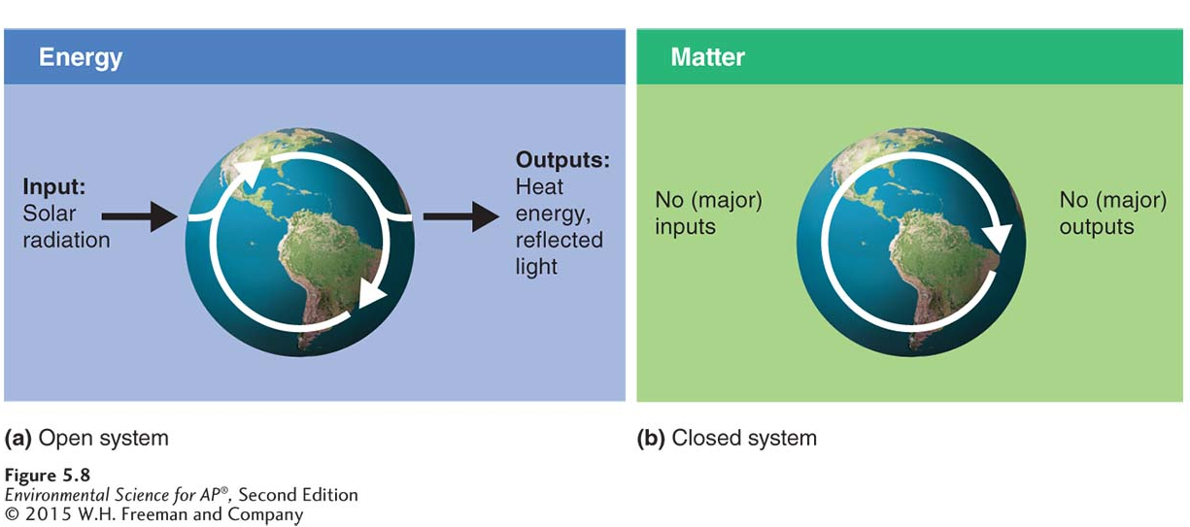
System Dynamics
Open and closed systems. (a) Earth is an open system with respect to energy. Solar radiation enters the Earth system, and energy leaves it in the form of heat and reflected light. (b) Earth is essentially a closed system with respect to matter because very little matter enters or leaves Earth’s system. The white arrows indicate the cycling of energy and matter.

Slide 31
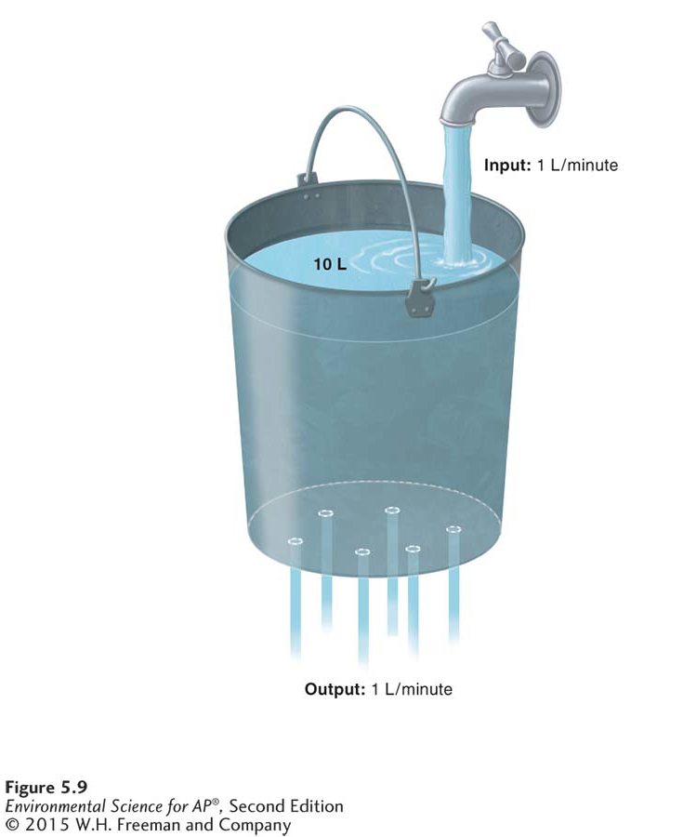
System Dynamics
A system in steady state. In this leaky bucket, inputs equal outputs. As a result, there is no change in the total amount of water in the bucket; the system is in steady state.

Slide 32
System Dynamics
Feedbacks are found throughout the environment.
Negative feedback loop A feedback loop in which a system responds to a change by returning to its original state, or by decreasing the rate at which the change is occurring.
Positive feedback loop A feedback loop in which change in a system is amplified.

Slide 33
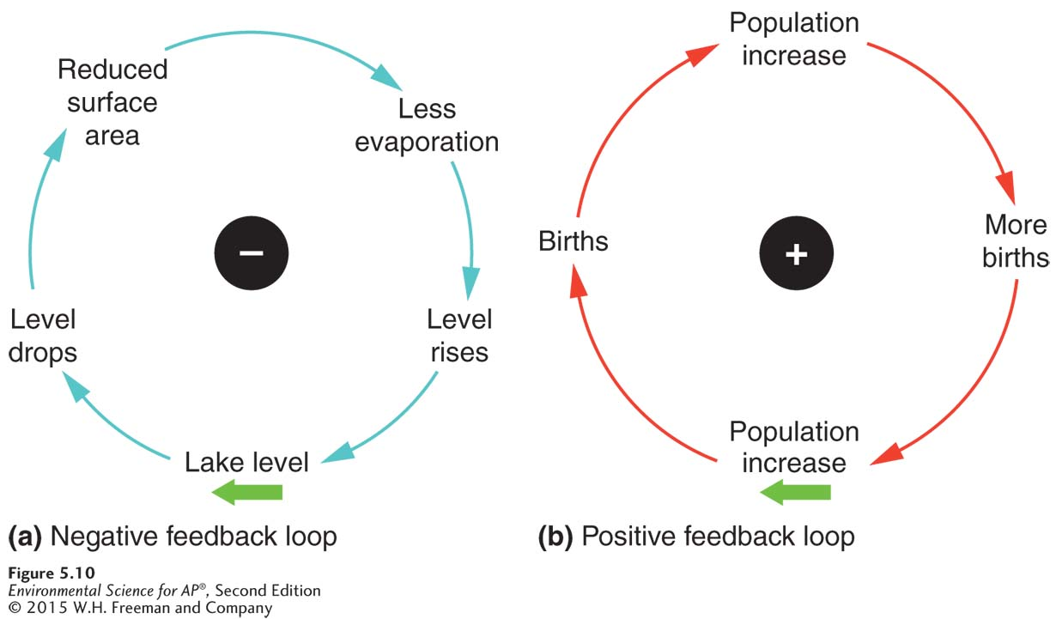
System Dynamics
Negative and positive feedback loops. (a) A negative feedback loop occurs at Mono Lake: A drop in water level reduces the lake surface area and evaporation decreases. The decrease in evaporation causes the lake level to rise again. (b) Population growth is an example of positive feedback. As members of a species reproduce, they create more offspring that will be able to reproduce in turn, creating a cycle that increases the population size. The green arrow indicates the starting point of each feedback loop.

