Slide 1
Chapter 10
The Mass Media and The Political Agenda

Slide 2
Political success depends on effectively communicating a message
“Going public” affects the beliefs of citizens and influences the policy agenda … which then has an effect upon policy
High Tech Politics: behavior of citizens and policymakers, and the policy agenda, shaped by technology
Mass Media: reach a large percentage of the population
Media Event: staged event meant to be covered via mass media; used to influence media coverage (and, therefore, public opinion)

Slide 9
Media Event: guides the media’s focus by staging carefully scripted events to report on; Trump’s “rallies”, pardoning the Thanksgiving turkey, Easter hunt hunt, visiting a business, etc.
Press conferences: meetings between the administration and reporters
“The President of the United States will not stand and be questioned like some chicken thief by men whose names he does not even know.”
- Herbert Hoover [1929-1933], regarding his feelings about
conferences

Slide 10
Press conferences: officials meeting with members of the press/media in order to influence their coverage, thus affecting the population at large
FDR’s ‘Fireside Chats’ were the notable beginning of Presidential press conferences
Investigative Journalism: presents the media in an adversarial, rather than complicit, role.
Text: “pits the media vs. leaders”
But … does it necessarily do so [foment a negative/antagonistic relationship]?

Slide 12
Federal Communications Commission
FCC created in 1934, regulates media [internet?]
Prevents monopolies (1996: no single owner can control >35% of a broadcast market)
Examinations of performance (serving the public interest?)
Fair Treatment Rules
Equal Time Rule (candidates and officeholders)
Right-of-Reply Rule
Fairness Doctrine (abandoned in late 1980s due to multiplicity of cable channels)

Slide 13
Broadcasting vs. Narrowcasting
Broadcasting: programming for a wide/diverse audience (NBC, CBS, ABC)
Effect?
Narrowcasting: segmentation of media that focuses on a particular audience/interest (MTV, ESPN, Fox News, Comedy Central)
Decreasing information homogeneity
Confirmation Bias (tendency to search for or interpret information in a way that confirms one's preconceptions/beliefs)
Declining news quality
Fewer written stories: 11% of news coverage
Reporters job: largely to blah blah blah [speak extemporaneously]
Repetition of stories without added content
Eye of Sauron: coverage is “spotty”; focused but narrow
Stories focus on sensational, rather than ‘important’

Slide 17
Internet
Unrivaled access to information/news
“Purposive”: people exposed to what they intentionally look for (leading to Confirmation Bias)
Largest effect: communication and political mobilization
Blogs: “news media now faces competition from people with an opinion, a modem, and a bathrobe.” [Brian Williams]
Vlogs
Social Media

Slide 20
Most Googled Question? (2015) "What is twerking?“
Most Googled Questions?
(2016)
1. What is Pokémon Go? 6. What is Aleppo?
2. What is a Caucus? 7. What is the mannequin challenge?
3. What is Brexit? 8. What is Citizens United?
4. What are electoral votes? 9. What is the European Union?
5. What is the Electoral College? 10. What is a Superdelegate?
2018: “What is Bitcoin?”

Slide 21
Most Googled Person (2015)?

Slide 22
Most Googled Person (2016)?

Slide 23
Most Googled Person, 2018 Demi Lovato

Slide 25
Most Googled, 2017
Questions
People
What is DACA?
What is Bitcoin?
What is a solar eclipse?
What is Antifa?
What is Net Neutrality?
What is covfefe?
What is a fidget spinner?
What is a hurricane?
What is the Paris Climate Agreement?
Matt Lauer
Meghan Markle
Harvey Weinstein
Michael Flynn
Kevin Spacey
Bill O’Reilly
Melania Trump
Kathy Griffin
Milo Yiannopoulos
Gal Gadot

Slide 26
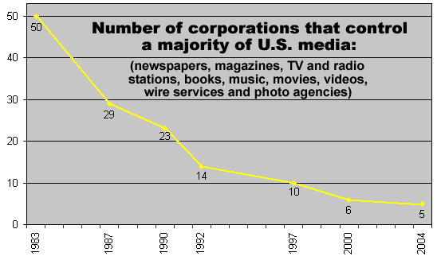
Virtually all media = private = ‘for profit’
Independent from government
Dependent on profit/financial success
Growing number of media conglomerates

Slide 28
Sinclair Broadcast Group
an American telecommunications company that is owned by the family of company founder Julian Sinclair Smith.
the company is the largest television station operator in the United States by number of stations, and largest by total coverage; owning and/or operating a total of 193 stations across the country (233 after all currently proposed sales are approved) in over 100 markets (covering 40% of American households)

Slide 29
Sinclair has faced scrutiny from media critics, as well as some of its station employees, for the conservative slant of their stations' local news reporting and other programming decisions, and how the company's rapid growth has aided its dissemination of content that appeal to these views.
Sinclair often mandates its stations to air specific reports, segments, and editorials, referred to as "must-runs"

Slide 37
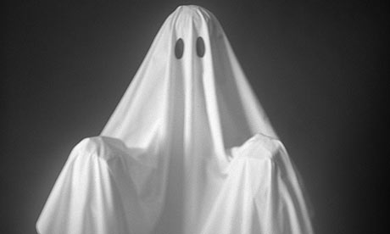
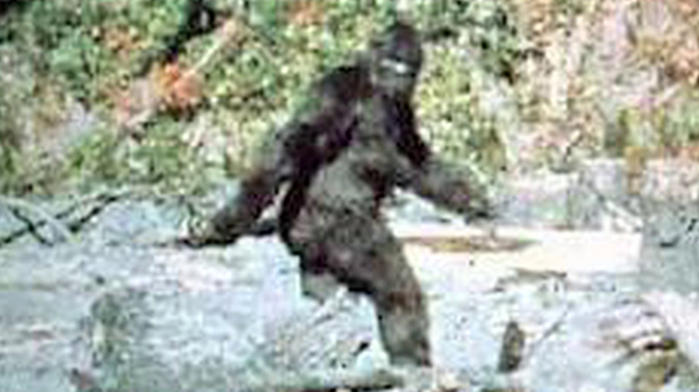
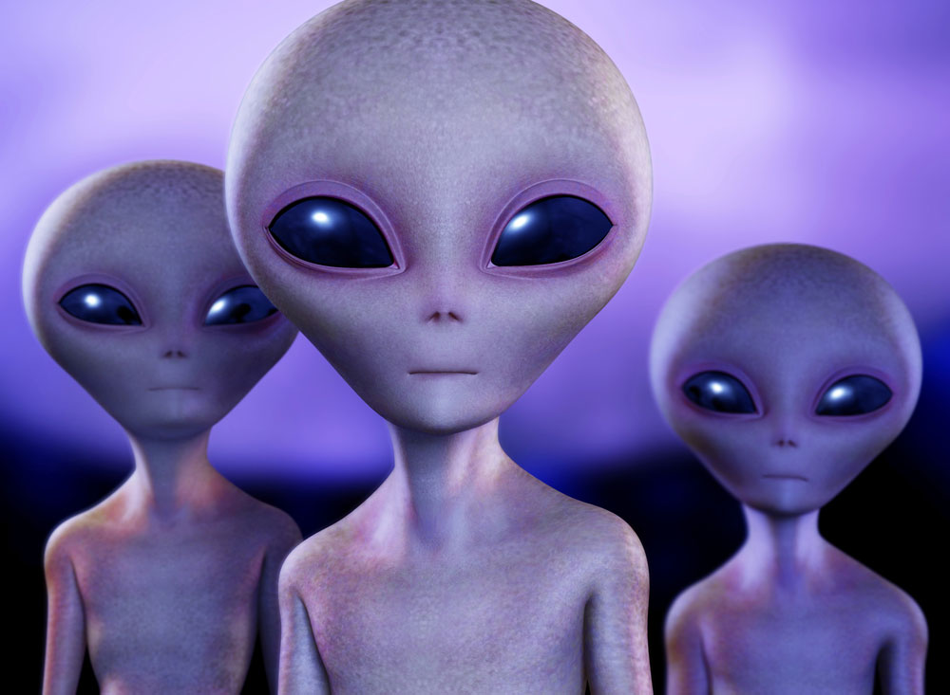

Slide 38
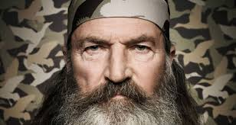

Slide 39
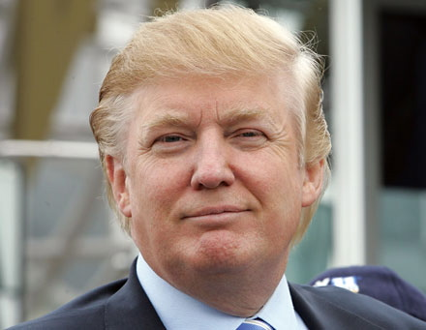
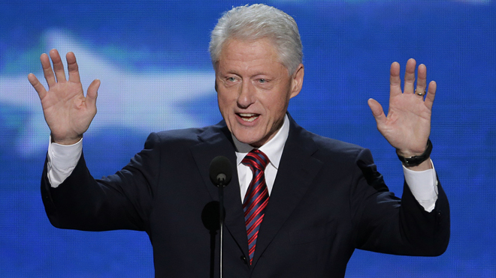

Slide 40
Effect of the Media on Public Opinion …
Television news can affect the perception of risk/priorities …
Alters the priorities Americans attach to a set of problems, all of which are plausible contenders for public concern
Meaning: the ‘Eye of Sauron’ can significantly influence the public’s perception of priorities and, therefore, the policy agenda of government (or, more alarmingly, vice-versa … the agenda of government may drive coverage of issues that influences the public’s support)

Slide 42
TOP 11 CAUSES OF DEATH, U.S. (2015)

