Slide 1
Chapter 16
The Federal Courts

Slide 4
Article III of the Constitution
Section 1.
The judicial power of the United States, shall be vested in one Supreme Court, and in such inferior courts as the Congress may from time to time ordain and establish. The judges, both of the supreme and inferior courts, shall hold their offices during good behaviour, and shall, at stated times, receive for their services, a compensation, which shall not be diminished during their continuance in office.

Slide 5
Criminal vs. Civil Law

Slide 6
Criminal vs. Civil Law

Slide 7
The Judiciary
Passive: litigants bring cases to court
Decides cases & controversies:
> not hypotheticals
“Standing to Sue”: litigant must have a ‘serious interest’ in a case
Have sustained, or are immediate danger of sustaining, a direct and substantial injury
Class Action suit: small number of litigants suing on behalf of all other similar people
Disputes must be justiciable: capable of being settled by legal means

Slide 8
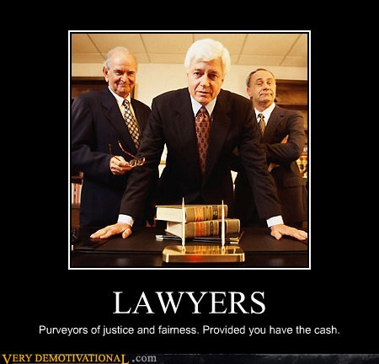
Actors in the Judicial System
Lawyers

Slide 9
Litigants
“The houses of lawyers are roofed with the skins of litigants”
(proverb)

Slide 10
Groups

Slide 11
When not directly finding good cases and good litigants to sponsor, groups may support litigants via amicus curiae (“friend of the court”) briefs.
> > > attempt to influence by argument, information, and new perspective/points-of-view

Slide 12
Judiciary Act of 1789
Established lower courts
91 federal District Courts
12 federal Courts of Appeal
1 Supreme Court (SCOTUS)

Slide 13
Original Jurisdiction: courts that hear a case first and determine the facts of a case
Appellate Jurisdiction: courts which hear cases brought to them on appeal from a lower court; facts are not disputed, but rather questions of the involved legal issues are examined

Slide 14
SCOTUS
Resolve conflicts between States
Maintain national supremacy in the law
Ensure uniformity in interpretation of federal law
9 Justices (8 Associates and 1 Chief Justice)
Last change in number was under Ulysses S. Grant

Slide 15
Anthony M. Kennedy, 1988 m/sv*
Ruth Bader Ginsburg, 1993 l
Stephen G. Breyer, 1994 l
Sonia Sotomayor, 2009 l
Elena Kagan, 2010 l
John G. Roberts, Jr., 2005 c
*Chief Justice of the United States
Neil Gorsuch, 2017 c
Clarence Thomas, 1991 c
Samuel Anthony Alito, Jr., 2006 c

Slide 16
Nearly all cases of the SCOTUS are appellate cases (from both federal and state courts)
Appeals from state courts must have a “substantial federal question” (involve federal law/Constitution and all state remedies have been exhausted)
Requests for review > discussed in conference > 4 votes to hear (“Rule of Four”) > placed on docket
About 99% of requests are denied, fewer than 100 of 8,000 are heard
Writ of Certiorari: formal document calling up the case from a lower court

Slide 17
Majority opinion: statement of legal reasoning behind decision.
Dissenting opinion: opposed to all or part of majority opinion.
Concurring opinion: supports the majority decision but stresses a different legal argument or constitutional provision.
Precedent: decisions guided by previous court decisions/reasoning.
Ties in voting on a case devolve to lower court decision
Per Curiam decision: decision without explanation.
Stare Decisis: “let the decision stand”; the earlier decision from lower court should hold.

Slide 18
Court decisions carry legal authority, but must rely upon other units of government to enforce them;
Judicial Implementation: how and whether court decisions are translated into governmental policy, thereby affecting the behavior of others.
Worcester v. Georgia: “John Marshall has made his decision, now let him enforce it.” (A. Jackson)
Brown v. Board of Education: 10 years after, only 1 in 85 black children attended an integrated school
Obergefell v. Hodges: as of June 22, 2016, thirteen counties, both in Alabama and Texas, still do not issue marriage licenses to same-sex couples; Kim Davis (County Clerk in Tennessee) ‘famous’ for refusal of licenses.

Slide 19
Judicial Selection
Senatorial Courtesy: unwritten tradition whereby nominations for state level federal courts are not confirmed if they are opposed by a senator (of President’s party) from that state

Slide 20
Judicial Discretion
Refers to the Courts’ interpretation of the Constitution
Original Intent, or Strict Constructionism: judges should attempt to determine the intent of the ‘Founders’ regarding a matter and make decisions in line with that.
Judges play minimal policymaking roles, deferring to the legislature = Judicial Restraint
Loose Constructionism: the Constitution is subject to multiple meanings by thoughtful people in different ages; many modern issues could not have been foreseen by the ‘Founders’ and, thus, require modern interpretation of Constitutional principles; also, the ‘Founders’ were not of unilateral opinion on virtually any subject.
Judges make novel policy decisions, even charting new constitutional ground, to correct pressing needs not met by the political process = Judicial Activism

Slide 21
Doctrine of ‘Political Questions’
An ideology that asserts that certain issues should not be decided by the courts, principally involving those between Congress and the President.
For example, the War Powers Act
President is commander-in-chief
War Powers Act asserts Congress’ power to restrict that warmaking power
President’s view this as a Legislative Veto, and therefore unconstitutional as a violation of separation of powers.

