Slide 1
Chapter 8: Political Parties

Slide 2
American government is defined by competition between the two dominant parties,
Democrats and Republicans.

Slide 5
Political Party: according to Anthony Downs, a “team of men and women seeking to control the government apparatus by gaining office in a duly constituted election”

Slide 6
A widely adopted way of thinking about parties in political science is as “three-headed political giants” :
(1) the party in the electorate;
(2) the party as an organization;
(3) the party in government

Slide 7
Party in the Electorate
By far the largest component of an American political party; consists of individuals that perceive themselves as party members
American parties do not require dues or membership cards, you become a member by simply saying you are one, even if you vote for the opposite party

Slide 9
Party as an Organization
Each party has a national office (also state and local offices), a full time staff, rules and bylaws, and budgets
There are leaders of the party who are the people that keep the party running between elections and make its rules
The party organization is always pursuing electoral victory

Slide 10
Tom Perez, elected February 2017
Democratic National Committee Chairperson

Slide 11
Ronna Romney McDaniel (elected January 2017) Republican National Committee Chairman

Slide 12
Party in Government
Consists of elected officials who call themselves members of the party
These leaders are the spokespersons for the party
They do not always agree with each other

Slide 13
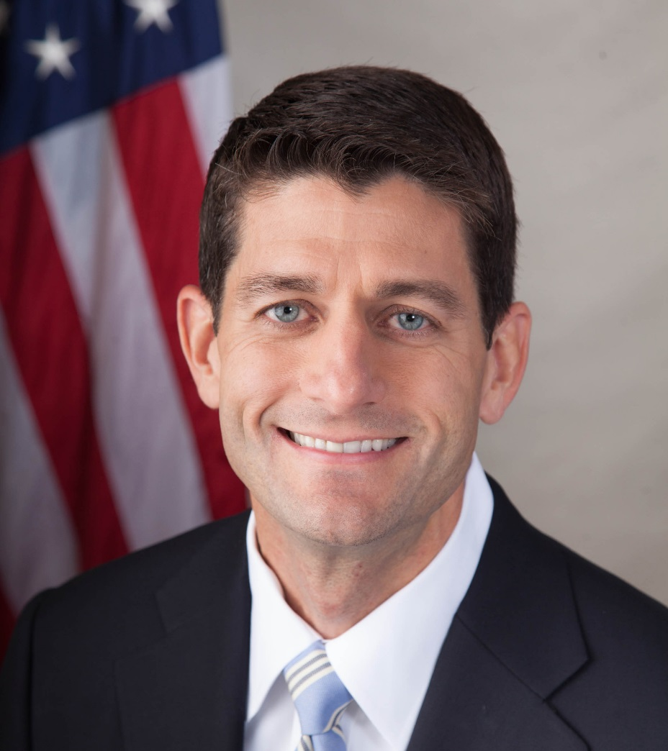
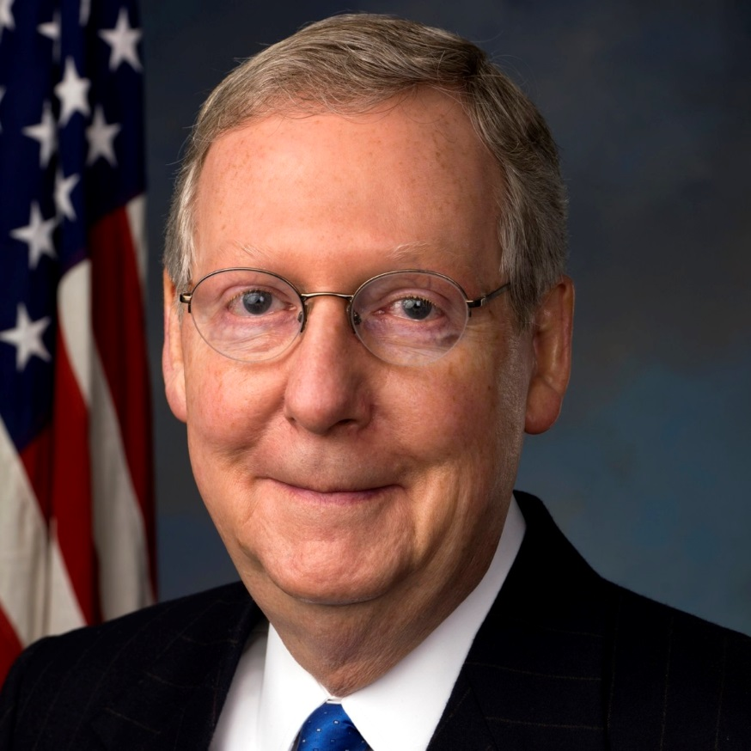

Slide 14
Linkage Institutions
The channels or access points through which issues and people’s policy preferences get on the government’s policy agenda
In the U.S. there are four: elections; political parties; interest groups; and the mass media
Linkage institutions help ensure that public preferences are heard

Slide 15
Tasks performed by Parties
1. Parties pick candidates: a person needs to be nominated, or endorsed, by their party

Slide 16
2. Parties run campaigns:
parties coordinate political campaigns, although with new technology it is easier for candidates to campaign on their own (ex. Ross Perot)

Slide 17
3. Parties give cues to voters:
many people rely on the party to give them the cues for voting
a. Party Image: the voter’s perception of what the Republicans or Democrats stand for, such as conservatism or liberalism

Slide 18
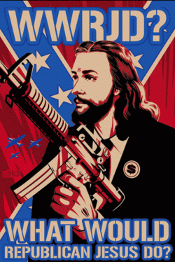
What is your perceived party image for:
Democrats? Republicans?

Slide 19
4. Parties articulate policies:
within the electorate and within the government, each political party advocates specific policy alternatives

Slide 20
5. Parties coordinate policymaking:
parties are essential for coordination among the branches of government; when a public official needs support to get something done, they look to their fellow partisans

Slide 21
Anthony Downs’ “Rational-Choice Theory”
a popular theory in political science to explain the actions of voters as well as politicians;
assumes that individuals act in their own best interest, carefully weighing the costs and benefits of possible alternatives

Slide 22
a. voters want to maximize the chance that policies they favor will be adopted by government
b. in order to win offices, the wise party selects policies that are widely favored
c. since the majority of the electorate are in the middle, successful parties rarely stray far from the midpoint of public opinion
d. there is frequent criticism that there is not much difference between the Democrats and the Republicans, however, given the nature of the American political market, they have no choice
e. parties do differentiate themselves to some extent in order to forge different identities and build voter loyalty
f. more than half of the population currently believes that important differences do exist between the parties

Slide 23
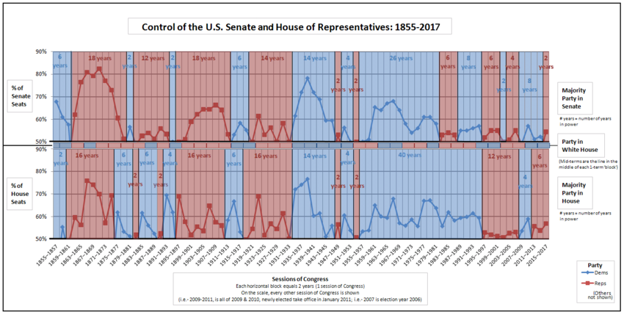
Party era: historical period where a party wins the majority of elections

Slide 24
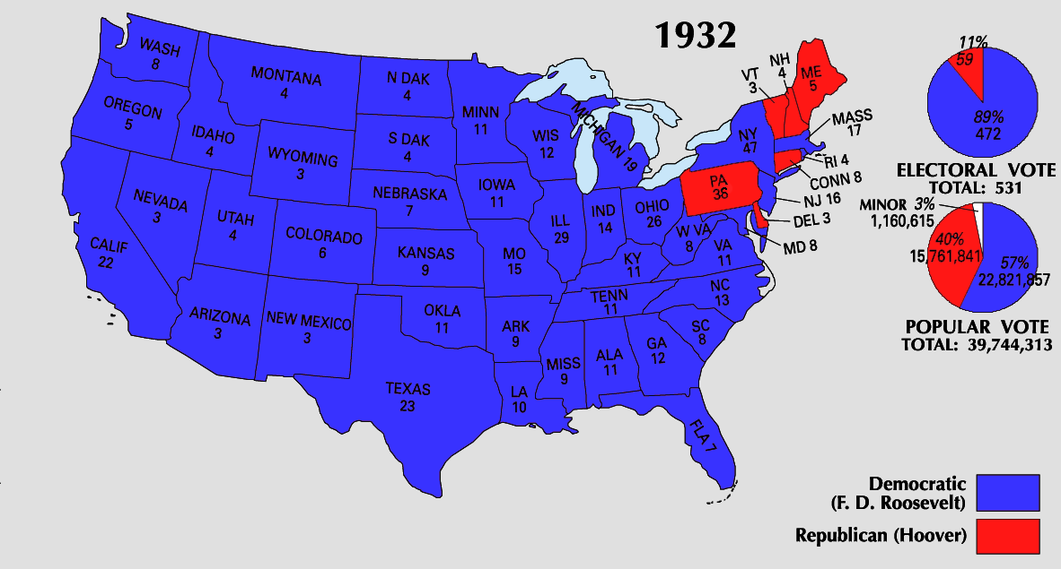
Critical election: new issues emerge, resulting in new coalitions and the majority party is displaced by the minority party
Party Realignment:
The displacement of the majority party by the minority party

Slide 25
Party Dealignment: the disengagement of people from parties

Slide 26
The American Two-Party System
Winner-Take-All system: whoever gets the most votes wins the election
Encourages smaller parties to merge with the dominant two parties to have any significant hope of success (‘Tea Party' > Republicans)
This is in opposition to other democracies’ who utilize Proportional Representation: legislative seats awarded to political parties based on the proportion of votes won in an election
Minority parties can have an effect even if they do not win elections; encourages Coalition Government (two or more parties join together to form a majority)

