Slide 1
Chapter 9
Nominations & Campaigns

Slide 2
Nomination
Party’s official endorsement of a candidate for office
Success
money + media attention + momentum
Campaign Strategy: way that candidates attempt to manipulate each of these elements in order to achieve nomination

Slide 3
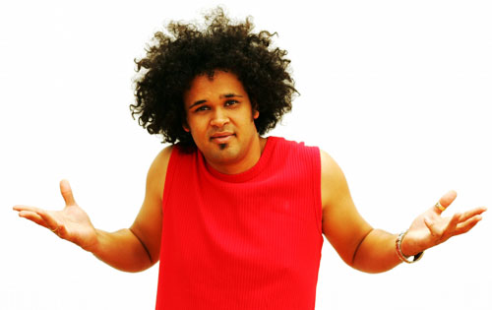
In most developed nations, campaigns last 2 months or less …
In the U.S., Presidential campaigns can be between 1 & 2 years.

Slide 4
Goal of nomination = win the support of the majority of delegates at the National Party Convention
1830s to 1960s: delegates were composed of political elites and chosen by state party “bosses”
1968 Democratic Party Convention: Issue of Vietnam war split party between pro-war delegates and anti-war party members

Slide 6
McGovern-Fraser Commission
Concession won by anti-war protestors to examine delegate selection process
Recommendation to open selection of delegates via primary elections and/or caucuses
Changes, enforced by state laws, extended to Republican Party, as well.

Slide 7
Effect of the ‘democratizing’ reforms?
In both 1972 and 1980, Democrats lost the White House by blowout proportions. Incumbent President Jimmy Carter carried only six states and the District of Columbia in 1980, which put him five states ahead of George McGovern's 1972 finish.
Party leadership felt that they had let the nominating process get away from them, so, in 1980, they asked North Carolina Gov. James B. Hunt to convene a committee on delegation guidelines. The Commission on Presidential Nominations eventually recommended a new category of convention participants: superdelegates.
These superdelegates would consist of party leaders and elected Democrats who would come to the 1984 convention untethered to any candidate. Party leaders believed that these superdelegates, perceived as more moderate and more politically seasoned than pledged delegates, would provide a counterweight to more "insurgent" forces.

Slide 10
The 2020 Democratic Party presidential primaries and caucuses will be a series of electoral contests organized by the Democratic Party to select the 3,768 delegates to the Democratic National Convention and determine the Democratic nominee for President of the United States in the 2020 U.S. presidential election.
The elections will take place within all 50 U.S. states, the District of Columbia, and five U.S. territories.
An extra 764 unpledged delegates or superdelegates, including party leaders and elected officials, will be appointed by the party leadership independently of the primary's electoral process. The convention will also approve the party's platform and vice-presidential nominee.
Following the 2016 presidential elections, significant changes were proposed that would change the number and role of superdelegates in the nomination process. Changes were enacted on August 25, 2018, which would allow superdelegates to vote on the first ballot at a convention only if it were uncontested.

Slide 11
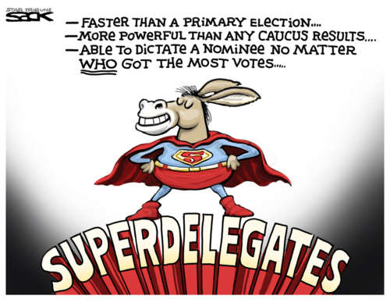
So …
Populist primaries/caucuses balanced by elitist Superdelegates
Officeholders/party members chosen by the national party
2008: 16% of Dems (about 1/3 needed for nomination), 6% of Reps

Slide 12
Primary
Voters go to polls
New Hampshire most prominent (1st)
Closed Primaries
Requires party registration
Open Primaries
No party registration required

Slide 13
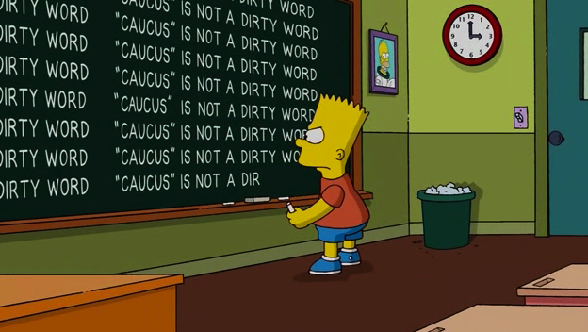
Caucus
Open meetings to determine delegate selection
Currently about 12 states, mostly rural. Iowa most prominent (as it’s the first state contest).
Takes 1-4 hours, resulting in lower turnout.

Slide 14
FRONTLOADING
States holding contests early in the ‘season’ to capitalize on attention and money.
About 2/3 of the delegates chosen within 6 weeks of the first caucus (Iowa)
Early states benefit from media attention, money, issues on the agenda
Generates “the big mo” = momentum
Media coverage, donations, support, etc.

Slide 16
Analysis of Primary Process
Early states receive large amounts of attention
$$$ and visits/events to establish a candidate as a “winner” (hoping for Bandwagon effect)
“Big Mo” (George H. W. Bush, 1980)
Difficult for incumbents
Hard to campaign and serve current job at the same time
Money plays “too big” a role
Staff, events, media, magnifies Bandwagon effect, etc.
Participation is low
25% compared to 60% in general election
Participation is non-representative: older & richer
Media has “too much” power
Pundits labeling winners and losers

Slide 17
Media Coverage
2 forms:
From campaign’s media budget (~1/2 TV)
“Free” attention as newsmakers
Most media coverage of candidates and campaigns is superficial, covering events of the day: where the candidate went, the size of the crowds, etc. & “Horserace Journalism”: covering public opinion polls & performance-to-date in primaries/caucuses

Slide 18
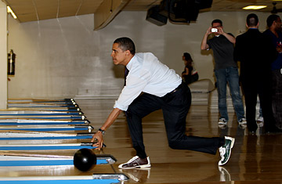

Slide 19
PARTY PLATFORM
Statement of goals and policies for the next four years
Drafted prior to the beginning of the convention(s)

Slide 20
DIRECT MAIL
Method of raising money via sending requests to lists of people who have supported similar issues/candidates in the past
Value of lists and Internet

Slide 21
Social Media

Slide 22
FEDERAL ELECTION CAMPAIGN ACT
Created 1974
Meant to reform campaign financing
Created Federal Election Commission (enforces finance laws)
Established guidelines for campaign financing

Slide 23
Buckley v. Valeo (1976)
Challenged FECA
Struck down the limitation on the amount that individuals could donate to their own campaigns
Issue: Free Speech

Slide 24
SOFT MONEY
Contributions intended to be used for party-building expenses or generic advertising
Another loophole to FECA limits
Banned by McCain-Feingold Act of 2002

Slide 25
Citizens United v. Federal Election Commission, (2010)
McCain-Feingold Act declared an unconstitutional restriction of free speech
Corporations and unions can spend unlimited amounts to promote their political views as long as they don’t coordinate with a candidate’s campaign

Slide 26
Political Action Committees
‘PACs’
Interest groups can form PACs in order to directly channel larger contributions to campaigns than allowed by individuals

