Slide 1
PUBLIC OPINION and POLITICAL ACTION

Slide 2
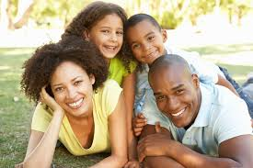
Political Socialization
Process through which an individual acquires their particular political orientations (knowledge, feelings, and evaluations)
Family
Mass Media
School
Religious groups
Peers
“Influencers”
(Political & Community
leaders)

Slide 3
Political Culture
An overall set of values widely shared throughout a society
e.g. Equality, Individualism

Slide 4
During the 2010–2011 season, Modern Family was the highest rated scripted show in the 18–49 demographic, and the third highest rated overall sitcom behind CBS's The Big Bang Theory and Two and a Half Men.

Slide 5
The fourth season premiere drew 11.8 million viewers; the most-watched nonfiction cable series in history.

Slide 9
DEMOGRAPHY
The study of human populations and population changes
Census as primary tool

Slide 15
U.S. Population Distribution by Race and Ethnicity (2010)
White 72.4 %
Hispanic/Latino 16.4%
African American 12.6 %
Asian American 4.8 %
American Indian/Alaska Native 0.9 %
Native Hawaiian/other Pacific Islander 0.2 %
Some other race 6.2 %
Two or more races 2.9 %

Slide 16
Minority Majority
2000: Hispanics become largest minority group (over A-As)
2008: Non-Hispanic white Americans = 66%
~2050: Minority majority

Slide 17
Immigration
Federal law allows for ~ 1 million new immigrants per year
Currently ~ 14.4% of population are immigrants (2015)
41% of this group are citizens
27% in CA are foreign-born (high)
1% in WVa are foreign-born

Slide 19
The 3 ‘Great Waves’ of Immigration
1800-1850: “Old Immigrants” NW Europeans
1880-1920: “New Immigrants” SE Europeans
1960-Present: Hispanic/Latinos, Asians
Melting Pot vs. Salad Bowl theories

Slide 21
Other Demographic Changes
Geographic population shift > political changes
Reapportionment > effects on political agenda
“Graying of America”
65+ fastest growing demographic group
Baby Boom
Social Security
Increased political participation and party attachment

Slide 22
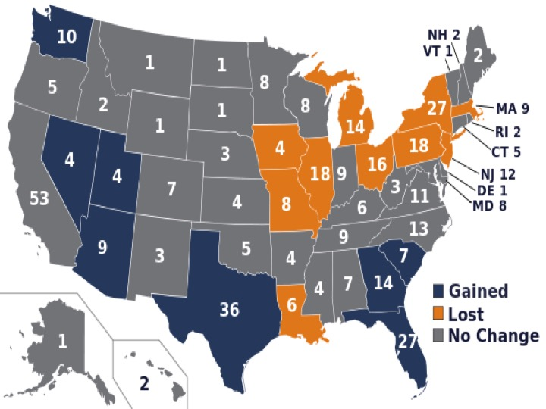

Slide 24
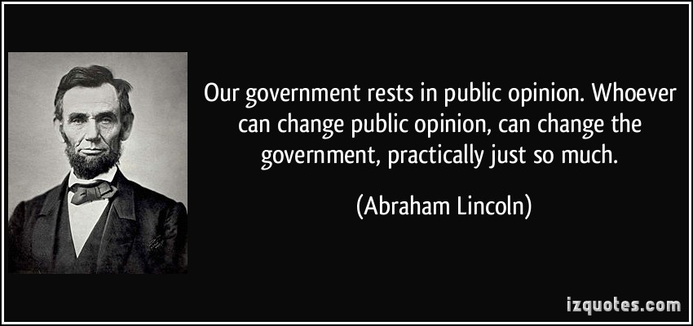
PUBLIC OPINION
The distribution of the population’s beliefs about politics and political issues

Slide 25
Measuring Public Opinion
A survey of a given population’s opinion on an issue or candidate at a particular point in time.
Public Opinion Polling first developed by George Gallup (1936)
Sample: relatively small proportion to represent the whole
1,000 to 1,500 can accurately represent the whole
Random Sampling key: everyone should have equal probability of being chosen; sample should be roughly equal to demography
Quota Sampling: sample is structured so that it is representative of the target population

Slide 26
Poll Legitimacy
Level of confidence = Sampling Error (or ‘Margin of Error’)
Typical SE = +/- 3%
This means that 95% of the time the results are within 3% of what the entire population thinks/feels.

Slide 27
Sampling Techniques
Random-Digit dialing: to reach listed, unlisted
~2% of population doesn’t have phones
People less willing to participate over the phone
2010: 1 in 4 households had cell phones only
2017: 51% households = cell phone only
Federal law prohibits use of automated dialers for cell numbers – so these must be done ‘by hand’

Slide 28
Exit Polls
Voting places selected at random
Workers ask every 10th person how they voted
Used to project electoral winners

Slide 29
Criticism of Polls
Sample size
Sample constituency (‘Straw Polls’, internet surveys)
Wording/Order of questions/answers
Cart-Leading-the-Horse
“Do you think that the $5.7 billion requested by Trump should be spent on a physical wall or on border security?”
Bandwagon Effect
“55% of Americans think that the shutdown was the fault of Trump/Republicans. Who do you think was responsible?”
Push Polls
“If it was revealed that Donald Trump consumed baby rabbits while they are still alive, would that make you more or less likely to vote for him?”
Exit Polls affect voting

Slide 30
“Paradox of Mass Politics”
Posited by Russell Neuman
Paradox: That American politics works as well as it does given the lack of public knowledge about politics
[2006: 74% of Americans could name the 3 Stooges … 42% could name the 3 Branches of government]
Youngest = score the worst

Slide 33
Decline in Trust in Government
Beginning in the late 1960s, the public’s trust in government has fallen
Vietnam, Watergate, Economic crisis of 1970s, Iran hostage crisis, Hurricane Katrina
Greatest impact of this loss of trust is upon social welfare programs …

Slide 34
“People need to trust the government when they pay the costs but do not receive the benefits, which is exactly what antipoverty and race-targeted programs require of most Americans”
Mark Hetherington

Slide 35
Declining trust in government has led to increasing belief that government solutions to social problems are wasteful and impractical, thereby draining public support for them
E.g. Health Care Reform

Slide 36
Political Ideology
A coherent set of beliefs about politics, public policy, and public purpose … which helps give meaning to political events
Liberals: 26%
Moderates: 38%
Conservatives: 36%
Helps to explain the restrained scope of American politics

Slide 38
Liberals vs. Conservatives

Slide 39
As A General Rule, How Do they Feel About …
Change?
Role of Government?
Equality?
Economics?
Social Policy?

Slide 40
Political Participation
Conventional:
Voting
Working to persuade others (letters, conversations, demonstrations, etc.)
Running for office/working in campaigns
Unconventional:
Protest
Civil Disobedience
Violence
The higher socio-economic status, the higher the level of participation.
Group Consciousness of minorities/women results in higher levels of participation.

Slide 41
But … the Mortgage Interest Tax Deduction …

Slide 42
Or …
83 percent of stocks are owned by one percent of the population.
Sales taxes, which disproportionately hit low-income families, are in force across the nation. Taxes on financial transactions, which would disproportionately affect the rich, barely exist.
This tax would raise $14.4 billion a year, enough to handle New York’s fiscal deficit, with $4.4 billion leftover.

Slide 43
Or …
The average effective tax rate for citizens (local, state, and federal) is ~40%
The effective tax rate for corporations is ~ 16%

