Slide 1
Healthcare, the Environment, and Energy Policymaking

Slide 3
Healthcare
Key indicator = Infant Mortality
Life Expectancy
U.S. spends more, as a % of GDP, than any other nation (17%)
How do we do … ?

Slide 7
Why So Expensive?
Overbuilt medical facilities
Few Incentives to be Efficient
No ‘single-payer’ system; government, private insurance, and individual out-of-pocket
New Drugs & Technologies
Malpractice lawsuits/insurance & “Defensive Medicine”
Uninsured & Underinsured

Slide 9
Evolution of Healthcare
WWII: wage freezes led to healthcare benefits being added to employment as an incentive for hiring
Medicare: ~43 million people/14%
Medicaid: ~43 million people/14%
Children’s Health Insurance Program (CHIP): ~11 million

Slide 11
Quality of Health
Income: 25% of those <$25,000/yr. uninsured
Race: 31% of Latinos, 19% of African-Americans (twice infant mortality of whites), 15% of whites uninsured (+5 years of life expectancy over A-A’s)
Age: 7 million children uninsured; 18-29 year-olds

Slide 13
Poor Health = Increased Costs
Lack of Preventive Care = +25% risk of dying
Lack of Prenatal and Neonatal care
Children: lack of proper immunizations, Dental care, prescription medication
For the poor with limited/no options, Medical Migration occurs (‘outsourcing’ medical care to foreign entities).

Slide 15
The Affordable Care Act
Coverage
Ends Pre-Existing Condition Exclusions for Children: Health plans can no longer limit or deny benefits to children under 19 due to a pre-existing condition
Keeps Young Adults Covered: If you are under 26, you may be eligible to be covered under your parent’s health plan
Ends Arbitrary Withdrawals of Insurance Coverage: Insurers can no longer cancel your coverage just because you made an honest mistake.
Guarantees Your Right to Appeal: You now have the right to ask that your plan reconsider its denial of payment
Costs
Ends Lifetime Limits on Coverage: Lifetime limits on most benefits are banned for all new health insurance plans
Reviews Premium Increases: Insurance companies must now publicly justify any unreasonable rate hikes
Helps You Get the Most from Your Premium Dollars: Your premium dollars must be spent primarily on health care – not administrative costs.
Care
Covers Preventive Care at No Cost to You: You may be eligible for recommended preventive health services. No copayment.
Protects Your Choice of Doctors: Choose the primary care doctor you want from your plan’s network.
Removes Insurance Company Barriers to Emergency Services: You can seek emergency care at a hospital outside of your health plan’s network.

Slide 16
ENVIRONMENTAL POLICY

Slide 18
Teddy Roosevelt
Encouraged the Newlands Reclamation Act of 1902 to promote federal construction of dams to irrigate small farms and placed 230 million acres (360,000 mi²) under federal protection.
Set aside more Federal land for national parks and nature preserves than all of his predecessors combined.
Established the United States Forest Service, signed into law the creation of five National Parks, and signed the year 1906 Antiquities Act, under which he proclaimed 18 new U.S. National Monuments.
He also established the first 51 Bird Reserves, four Game Preserves, and 150 National Forests, including Shoshone National Forest, the nation's first.
The area of the United States that he placed under public protection totals approximately 230,000,000 acres.

Slide 20
1970’s

Slide 21
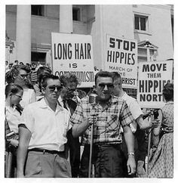

Slide 22
Environmental Protection Agency (EPA)
Nation’s largest regulatory agency
Environmental Impact Statement (EIS)
Clean Air Act
Water Pollution Control Act
Endangered Species Act
Superfund
Fund, created by taxing chemical prodcuts, to clean up waste sites
Nuclear Waste “NIMBY”
Global Warming

Slide 24
ENERGY POLICY

Slide 25
COAL: 90% of U.S. energy resources 22% of energy used 48% of electricity created

Slide 27
PETROLEUM: 37% of energy used 57% of supplies imported

Slide 28
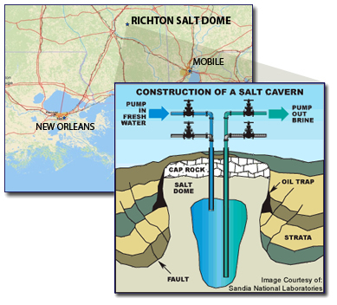
Strategic Oil Reserve: created after 1973 embargo; underground salt caverns along Gulf of Mexico

Slide 29
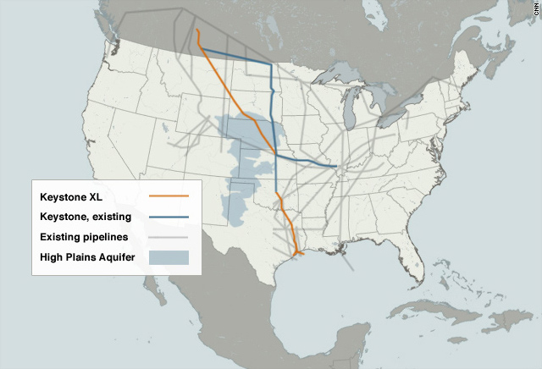
Future sources/issues with oil exploration:
Difficulty to find/access (muy expensivo)
Pipeline issues
Public lands
Offshore drilling

Slide 30
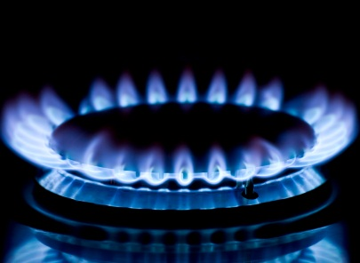
NATURAL GAS: 21% of energy used

Slide 31
NUCLEAR POWER: 21% of energy

Slide 32
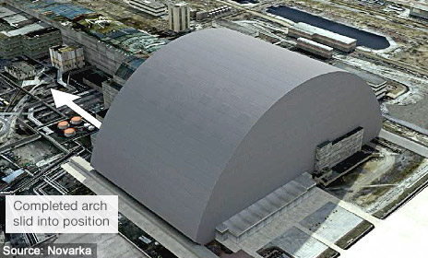
Concerns over nuclear power:
No new plants have been constructed since 1978 (‘NIMBY’)
Accidents: Three Mile Island, 1979;
Chernobyl, 1986
Also concerns over transportation, mining, disposal of waste

Slide 33
RENEWABLE ENERGY: 6-10% of energy used

Slide 34
Chapter Summary
Healthcare, environmental, & Energy policies all share:
Concerns over human health & welfare
Requirements to expand the scope of government
Highly technical: Does ignorance of technical issues mean citizens cannot participate effectively in policy debates (anti-vaxx, global warming, nuclear power, fracking, etc.)?

