Slide 1
Civil Liberties & Public Policy

Slide 3
Civil Liberties
Individual legal and constitutional protections against the government
Enumerated, primarily, in the Bill of Rights (first 10 amendments to the Constitution)

Slide 6
Barron v. Baltimore (1833)
The Bill of Rights restrained only the national government, not states and cities.

Slide 7
Gitlow v. New York (1925)
The Court upheld the state law which made it a crime to advocate the duty, need, or appropriateness of overthrowing government by force or violence.
Held that freedoms of press and speech are fundamental personal rights and are protected by the 14th amendment’s due process clause from impairment by the states
Beginning of the “Incorporation Doctrine”

Slide 8
Incorporation Doctrine
the legal concept under which the Supreme Court has nationalized the Bill of Rights by making most of its provisions applicable to the states through the Fourteenth Amendment
a. not everyone agreed with this idea that the 14th Amendment incorporated parts of the Bill of Rights into state laws; in 1985, Edwin Meese (then U.S. Attorney General) strongly criticized Gitlow and called for the disincorporation of the Bill of Rights
b. gradually the Supreme Court applied most of the Bill of Rights to the states, particularly during the era of chief Justice Earl Warren in the 1960s
c. so far only the 3rd, and 7th Amendments, the grand jury requirement of the 5th Amendment, and the prohibition against excessive fines and bail in the 8th Amendment have not been applied to the states

Slide 9
“FREEDOM OF RELIGION”
The 1st amendment does not, in fact, specifically protect the “freedom of religion” … instead, it creates two very specific limitations on government re: religion > “Congress shall make no law respecting an establishment of religion, or prohibiting the free exercise thereof; … ”

Slide 10
“
THE “ESTABLISHMENT CLAUSE”

Slide 12
The Danbury Baptists were a religious minority in Connecticut, and they complained that in their state, the religious liberties they enjoyed were not seen as immutable rights, but as privileges granted by the legislature — as "favors granted."
Jefferson's reply did not address their concerns about problems with state establishment of religion - only of establishment on the national level. The letter contains the phrase "wall of separation between church and state," which led to the short-hand for the Establishment Clause that we use today:
“Separation of church and state."

Slide 14
“Believing with you that religion is a matter which lies solely between man & his god, that he owes account to none other for his faith or his worship, that the legitimate powers of government reach actions only, and not opinions, I contemplate with sovereign reverence that act of the whole American people which declared that their legislature should make no law respecting an establishment of religion, or prohibiting the free exercise thereof, thus building a wall of separation between church and state. Adhering to this expression of the supreme will of the nation in behalf of the rights of conscience, I shall see with sincere satisfaction the progress of those sentiments which tend to restore to man all his natural rights, convinced he has no natural right in opposition to his social duties.”
(signed) Thomas Jefferson Jan.1.1802.

Slide 15
So, Jefferson envisaged a complete separation of religion and government … but that conception of the Establishment Clause has evolved.
Recent decisions of the Supreme Court have demonstrated a willingness for there to be some overlap of the two, as long as that overlap is NEUTRAL.

Slide 18
Reynolds v. United States (1878)
George Reynolds was a member of The Church of Jesus Christ of Latter-day Saints, charged with bigamy.
Decision [9-0]: “Congress was deprived of all legislative power over mere [religious] opinion, but was left free to reach [only those religious] actions which were in violation of social duties or subversive of good order.”
The court considered that if polygamy was allowed, someone might eventually argue that human sacrifice was a necessary part of their religion, and "to permit this would be to make the professed doctrines of religious belief superior to the law of the land, and in effect to permit every citizen to become a law unto himself."
The Court believed the First Amendment forbade Congress from legislating against opinion, but allowed it to legislate against action with neutrally enforced criminal laws

Slide 19
Lemon v. Kurtzman (1971)
Aid to church related schools did not necessarily violate the establishment clause of the 1st amendment
Creates the “Lemon Test” >
Must have a secular legislative purpose.
It’s primary effect must neither advance nor inhibit religion.
Must not foster an “excessive entanglement” with religion.
***To be Constitutional, no ‘prong’ can be violated***

Slide 20
1984 Equal Access Act
Congress made it unlawful for any public high school receiving public funds to keep student groups from using school facilities for religious worship if the school opens its facilities for other student meetings.

Slide 22
Engel v. Vitale (1962)
State officials violated the 1st amendment establishment clause when they wrote a prayer to be recited by schoolchildren
“Almighty God, we acknowledge our dependence
upon Thee, and we beg Thy blessings upon us,
our parents, our teachers and our country.
Amen.”

Slide 23
School District of Abington Township, Pennsylvania v. Schempp (1963)
Requirement of Bible reading in schools violated 1st amendment, establishment clause
“The place of religion in our society is an exalted
one, but in the relationship between man and
religion, the State is firmly committed to a
position of neutrality”

Slide 24
Wallace v. Jaffree (1985)
Alabama law authorized teachers to set aside one minute at the start of each day for a moment of "silent meditation or voluntary prayer“

Slide 25
One of the well-established criteria for determining the constitutionality of a statute under the Establishment Clause is that the statute must have a secular legislative purpose.
The First Amendment requires that a statute must be invalidated if it is entirely motivated by a purpose to advance religion.
The record here not only establishes that the purpose was to endorse religion, it also reveals that the enactment of the statute was not motivated by any clearly secular purpose. ... The State's endorsement, by enactment of prayer activities at the beginning of each school day, is not consistent with the established principle that the government must pursue a course of complete neutrality toward religion.

Slide 26
Lynch v. Donelly, 1984 and County of Allegheny v. American Civil Liberties Union, 1992
Recent Court rulings that brought some lowering of the “wall of separation” by allowing religious scenes to be set up on public property
a. Christmas trees and a menorah have a secular purpose and provide “little or no benefit to religion”
b. Court did say however that a Nativity scene, alone, could not be displayed at a courthouse.

Slide 28
Santa Fe School District v. Doe (2000)
Prior to 1995, a student elected as ‘student council chaplain’ delivered a prayer over the public address system before each home varsity football game.
The District claimed its policy did not violate the Establishment Clause because the football game messages were private student speech, not public speech.
ISSUE: Does the School District's policy permitting student-led, student-initiated prayer at football games violate the Establishment Clause?

Slide 29
Yes. In a 6-3 opinion, the Court concluded that the football game prayers delivered "on school property, at school-sponsored events, over the school's public address system, by a speaker representing the student body, under the supervision of school faculty, and pursuant to a school policy that explicitly and implicitly encourages public prayer” were public speech and that the District's policy involved both perceived and actual government endorsement of the delivery of prayer at important school events.
"Regardless of the listener's support for, or objection to, the message, an objective Santa Fe High School student will unquestionably perceive the inevitable pregame prayer as stamped with her school's seal of approval."

Slide 30
However …
"Nothing in the Constitution as interpreted by this Court prohibits any public school student from voluntarily praying at any time before, during, or after the school day"

Slide 31
The Constitution does not require complete
separation of church and state; it mandates
accommodation of all religions and forbids
hostility toward any. At the same time, the
Constitution forbids government endorsement
of religious beliefs.

Slide 32
THE FREE EXERCISE CLAUSE

Slide 33
Free Exercise
The Supreme Court has consistently maintained that people have an absolute right to believe what they want, but the courts have been more cautious about the right to practice a belief
The Court used to need a compelling interest before the government could even indirectly limit or prohibit religious practices

Slide 34
Employment Division v. Smith (1990)
Laws interfering with religious practices but not specifically aimed at religion are constitutional
A general law may be applied to conduct even if that law is religiously inspired
In Smith, Oregon was allowed to prosecute persons using Peyote in their religious rituals
This decision discarded the ‘compelling state interest’ doctrine

Slide 36
Even before this ruling the Court had upheld laws that:
forbid polygamy; denied tax exemptions to religious schools that discriminate on the basis of race; approved building a road through ground sacred to some Native Americans; prohibited a Jewish air force captain from wearing his yarmulke (Congress later allowed this)
The Court has allowed the free exercise of religion in: allowing parents to choose religious schools over public schools; Jehovah’s Witnesses or members of other religions do not have to participate in public school flag-saluting; people can be conscientious objectors to war on religious grounds; allowed animal sacrifices

Slide 37
Wisconsin v. Yoder (1972)
Court allowed Amish parents to remove children from school after the 8th grade
The Amish community was “well established and that its children would not burden the state” … the Court held that religious freedom took precedence over compulsory education laws

Slide 38
Church of the Lukumi Babalu Aye, Inc. v. City of Hialeah (1993)
Santerian church, practices animal sacrifice
Court overturned laws preventing animal sacrifice in religious rituals
Governments which permit other forms of animal killing may not ban sacrificial/ritual killings.
No “compelling state interest” that justified the abridgement of free exercise of religion

Slide 39
Freedom of Speech / “Expression”

Slide 40
FREEDOM OF SPEECH
Freedom of Speech includes many facets, from most-protected to least protected:
“Pure Speech”
“Symbolic Speech” or Expression
Student Speech
School-Sponsored Speech
Commercial Speech
“Pure Action”

Slide 41
Schenck v. United States (1919)
“The most stringent protection of free speech would not protect a man in falsely shouting fire in a theatre and causing a panic. [...] The question in every case is whether the words used are used in such circumstances and are of such a nature as to create a clear and present danger that they will bring about the substantive evils that Congress has a right to prevent.”
Court declares government can limit speech if it provokes a “clear and present danger”

Slide 42
Dennis v. United States (1951): upheld prohibitions on speech advocating the violent overthrow of the U.S. government
Yates v. United States (1957): permissible to advocate for the violent overthrow in the abstract, but not actually incite anyone to “imminent lawless action”

Slide 43
obscenity

Slide 44
Roth v. United States (1957)
Ruled that “obscenity is not within the area of constitutionally protected speech or press”
Thus upheld the convictions of Roth for publishing and sending obscene material over the mail.
Problems defining ‘obscenity’ then became common …

Slide 45
Justice Potter Stewart
"I shall not today attempt further to define the kinds of material I understand to be embraced within that shorthand description; and perhaps I could never succeed in intelligibly doing so. But I know it when I see it, and the motion picture involved in this case is not that."

Slide 46
Miller v. California (1973)
Classified “obscenity”
Materials were obscene if > > >
The work, taken as a whole, appealed to a “prurient interest in sex”
The work showed “patently offensive” sexual conduct
The work, taken as whole, lacked “serious literary, artistic, political, or scientific value”

Slide 47
PRURIENT adj
marked by or arousing an immoderate or unwholesome interest or desire; especially : marked by, arousing, or appealing to sexual desire
unusually or morbidly interested in sexual thoughts or practices
exciting or encouraging lustfulness; erotic

Slide 48
Miller held that ‘community standards’ should be used to determine whether material was obscene, i.e. Juries
Osborne v. Ohio, 1991: Court upheld Ohio’s law forbidding the possession of child pornography

Slide 49
SYMBOLIC SPEECH

Slide 50
Tinker v. Des Moines, 1965
Court upheld the rights of students to wear armbands as a sign of protest; “Free Speech protections went beyond the spoken word”
Students did not “shed their rights at the schoolhouse gate” and that students had free speech protections at school provided the expression did not constitute a ‘material and substantive disruption to the educational process’

Slide 52
Texas v. Johnson, 1989
Court struck down a law banning burning the American flag on the grounds that such action was symbolic speech and not just “dramatic action”

Slide 54
STUDENT SPEECH
Tinker v. Des Moines: “It can hardly be argued that either students or teachers shed their constitutional rights to freedom of speech or expression at the schoolhouse gate.”
The Court held that in order for school officials to justify censoring speech, they "must be able to show that [their] action was caused by something more than a mere desire to avoid the discomfort and unpleasantness that always accompany an unpopular viewpoint," allowing schools to forbid conduct that would "materially and substantially interfere with the requirements of appropriate discipline in the operation of the school.“
The Court found that the actions of the Tinkers in wearing armbands did not cause disruption and held that their activity represented constitutionally protected symbolic speech.

Slide 55
Hazelwood School District v. Kuhlmeier, 1988: Court ruled that a high school newspaper was not a public forum and could be regulated in “any reasonable manner” by school officials

Slide 56
Bethel School District v. Fraser, 1986
On April 26, 1983, Matthew Fraser, a Pierce County, Washington high school senior, gave a speech nominating classmate Jeff Kuhlman for Associated Student Body Vice President. The speech was filled with sexual innuendoes, but not obscenity, prompting disciplinary action from the administration. Fraser's speech was as follows:

Slide 57
"I know a man who is firm - he's firm in his pants, he's firm in his shirt, his character is firm - but most [of] all, his belief in you the students of Bethel, is firm. Jeff Kuhlman is a man who takes his point and pounds it in. If necessary, he'll take an issue and nail it to the wall. He doesn't attack things in spurts - he drives hard, pushing and pushing until finally - he succeeds. Jeff is a man who will go to the very end - even the climax, for each and every one of you. So please vote for Jeff Kuhlman, as he'll never come between us and the best our school can be. He is firm enough to give it everything.”

Slide 59
Fraser was found to be in violation of a school policy against disruptive behavior. These grounds later evolved to include obscenity at trial, but obscenity, according to Fraser, was not listed as grounds for his punishment in his initial hearing with school vice-principal Christy Blair. Fraser was suspended from school for two days, was prohibited from speaking at his graduation ceremony, and his name was stricken from the ballot used to elect three graduation speakers. Fraser nonetheless was selected by a write-in vote which placed him second overall among the top three finishers, although Bethel High School administrators refused to accept the write-in vote as a valid result, and continued to deny Fraser the opportunity to speak at graduation.

Slide 60
The US Supreme Court reversed the Court of Appeals in 7-2 vote to uphold the suspension, saying that the school district's policy did not violate the First Amendment.
Though the Court distinguished its 1969 decision Tinker v. Des Moines, which upheld the right for students to express themselves where their words are nondisruptive and could not be seen as connected with the school, the ruling in Fraser can be seen as a limitation on the scope of that ruling, prohibiting certain styles of expression that are sexually vulgar.

Slide 61
VULGAR
not having or showing good manners, good taste, or politeness
lacking in cultivation, perception, or taste
offensive in language
lewdly or profanely indecent

Slide 62
Marineau v. Guiles, 2006
The plaintiff in this case, a student at Williamstown Middle High School in Vermont, had worn a T-shirt …

Slide 64
After plaintiff had worn this shirt several times over a period of weeks, another student complained to a teacher, but was informed that the shirt constituted political speech, protected by law.
However, after receiving a complaint from a parent, the defendant in the case, a school employee, asked the student to cover up the parts of the shirt pertaining to drugs and alcohol, or turn the shirt inside-out, or wear a different shirt, in accordance with the school system's dress code, which prohibits
"any aspect of a" student's "appearance, which constitutes a real hazard to the health and safety of self and others or is otherwise distracting," (emphasis added) including "[c]lothing displaying alcohol, drugs, violence, obscenity, and racism."

Slide 65
The student refused, was given a referral, and sent home. After the student returned to school, he wore the T-shirt covered by duct tape (as required by the school), on top of which was written the word "censored."
The student sued the school administrators in order to have the disciplinary referral expunged from his record, and to enjoin the school from enforcing the dress code policy against him. The district court, applying the Supreme Court precedent set in Bethel School District No. 403 v. Fraser, held that the images depicted on the shirt were "plainly offensive or inappropriate" and that the school was therefore entitled to enforce its dress-code policy, but also ordered the expungement of the offense from the student's disciplinary record. Both the plaintiffs and the defendant appealed.

Slide 66
The court of appeals held that the T-shirt, in spite of its depiction of drugs and alcohol, was protected speech under the First and Fourteenth Amendments to the Constitution of the United States.
The court held that the plaintiff's rights were violated even by the limited intervention of the school staff (who had given the plaintiff the choice of changing shirts, wearing the shirt inside out, or covering the depictions of drugs and alcohol).
The court stated that "[t]he pictures" that the school administrators wanted the student to obscure "are an important part of the political message" that he "wished to convey, accentuating the anti-drug (and anti-Bush) message.
By covering them, defendants “diluted” the student's "message, blunting its force and impact. Such censorship may be justified under Tinker only when the substantial disruption test is satisfied."
As the student had worn the shirt on several days with no disruption to classroom activities, there are no grounds for the school to take any action against him.

Slide 67
Morse v. Frederick, 2007
“BONG HiTS 4 JESUS”
The United States Supreme Court held that the First Amendment does not prevent educators from suppressing student speech, at a school-supervised event, that is reasonably viewed as promoting illegal drug use.

Slide 69
In 2002, high school principal Deborah Morse suspended 18-year-old Joseph Frederick after he displayed a banner reading "BONG HiTS 4 JESUS" across the street from the school during the 2002 Olympic Torch Relay. Frederick sued, claiming his constitutional rights to free speech were violated. His suit was dismissed by the federal district court, but on appeal, the Ninth Circuit reversed, concluding that Frederick's speech rights were violated.
Chief Justice Roberts, writing for the majority, concluded that the school officials did not violate the First Amendment. To do so, he made three legal determinations:
first, that the "school speech" doctrine should apply because Frederick's speech occurred "at a school event";
second, that the speech was "reasonably viewed as promoting illegal drug use"; and
third, that a principal may legally restrict that speech—based on the three existing First Amendment school speech precedents, other Constitutional jurisprudence relating to schools, and a school's "important—indeed, perhaps compelling interest" in deterring drug use by students.

Slide 70
J.S. v. Blue Mountain School District, 2011
In March 2007, the Blue Mountain School District suspended two eighth-grade students after they created a fake MySpace profile for James McGonigle, principal of the Blue Mountain Middle School in Pennsylvania. The MySpace page did not identify McGonigle by name, but it included his picture from the school district's website and identified the person depicted as a “Principal."
According to court documents, the profile characterized the principal as a sex-obsessed pedophile, and it was laced with profanity and other negative comments about McGonigle and his family.

Slide 71
The school determined that the two students had violated the school discipline code, which prohibits making false accusations against school staff members.
It also determined that the students violated the school's computer use policy, which informs students that they cannot use copyrighted material without permission (McGonigle's photo from the school's website).
As a result, the school suspended the two students for ten days.

Slide 72
J.S. and her parents sued the School District, alleging that:
the suspension violated J.S.’s First Amendment free speech rights,
that the School District’s policies were unconstitutionally overbroad and vague,
that the School District acted outside of its authority in punishing J.S. for out-of-school speech.

Slide 73
DECISION
“Because J.S. was suspended from school for speech that indisputably caused no substantial disruption in school and that could not reasonably have led school officials to forecast substantial disruption in school, the School District’s actions violated J.S.’s First Amendment free speech rights.
“ … However, we will affirm the District Court’s judgment that the School District’s policies were not overbroad or void-for-vagueness”

Slide 74
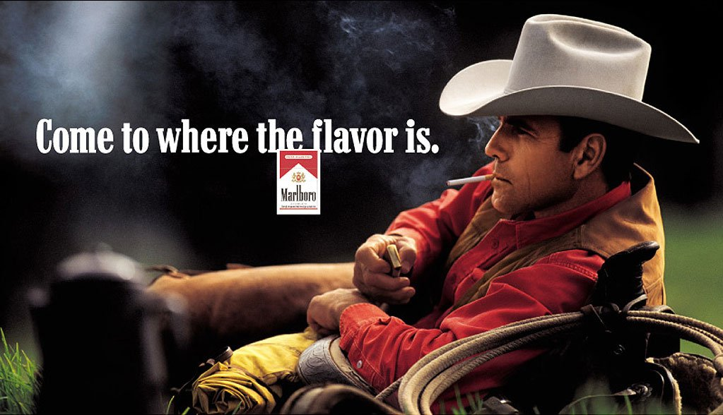
COMMERCIAL SPEECH

Slide 75
Communication in the form of advertising
Restricted far more than expressions of opinion on religious, political, or other matters
Federal Trade Commission (FTC): decides what kinds of materials may be advertised on radio and television, and regulates the content of advertising
a. these regulations change with social
mores and priorities

Slide 76
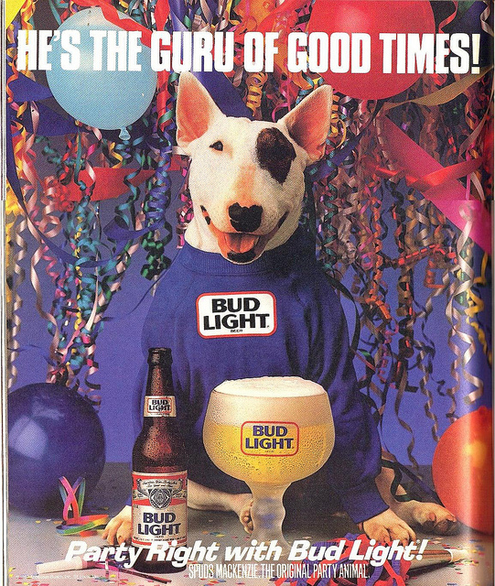
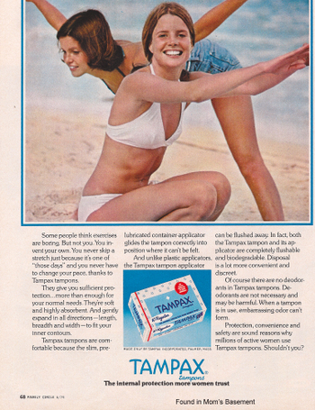
b. Ex. > 30 years ago there would be no tampon commercials but a lot of cigarette commercials – the reverse is true today

Slide 77
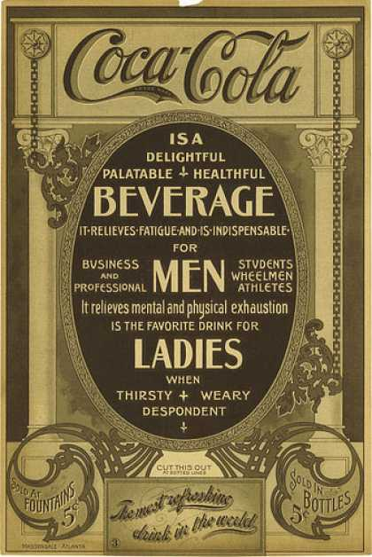
The FTC also ensures that
advertisers do not make
false claims for their
products.
a. truth in advertising does not prevent misleading promises
> ‘low fat’
> ‘light’
> ‘organic’
> ‘natural’

Slide 78
Regulating “Indecency”

Slide 79
Federal Communications Commission (FCC)
Regulates the content, nature, and very existence of radio and television broadcasting

Slide 80
CBS Corp. v. FCC, 2011
FCC fined New York-based CBS $550,000 for ‘indecency’ after viewers got a glimpse of Janet Jackson’s breast for 9/16 of a second during the 2004 Super Bowl halftime show.
U.S. Court of Appeals in Philadelphia ruled in July 2008 that the FCC’s policy on determining indecency was “arbitrary and capricious” and tossed the agency’s $550,000 fine.

Slide 81
FREEDOM OF THE PRESS

Slide 82
Near v. Minnesota (1931)
The 1st amendment protects newspapers from prior restraint (government censorship)
Hazelwood School District v. Kuhlmeier (1988): High School newspapers were not ‘public forums’ and could be regulated in “any reasonable manner” by school officials
Prior Restraint is also found constitutional in national security/classified information cases

Slide 83
Libel: the publication of false or malicious statements that damages someone’s reputation (Slander is spoken defamation)
New York Times v. Sullivan, 1964: Court established the guidelines for determining whether public officials and public figures could win damage suits for libel
a. Court said that statements about public figures are libelous only if made with malice and reckless disregard for the truth
b. the right to criticize the government or public official is not libel or slander
Private persons only need to show that statements about them were defamatory falsehoods and that the author was negligent
It is unusual for someone to win a libel case
a. Usually most people do not want to draw attention to critical statements made about them
Courts have ruled that parodies and jokes are allowed a lot of freedom when it comes to public figures

Slide 84
Two facets of the freedom of assembly: Right to Assemble: to gather together in order to make a statement

Slide 85
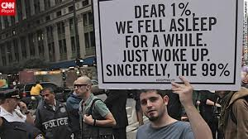

Slide 86
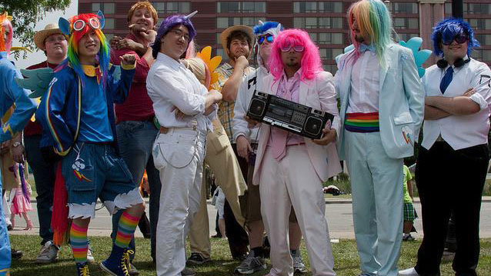
Right to Associate: freedom to associate with people who share a common interest

Slide 87
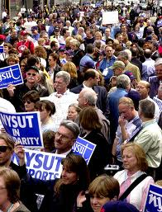

Slide 88
Freedom of Assembly
The freedom to assemble is the basis for forming interest groups and political parties, for picketing and protesting in groups
1. this freedom can conflict with other societal values when it disrupts public order (traffic, peace, quiet, etc)
2. Time, Place, and Manner: within reasonable limits, freedom of assembly includes the rights to parade, picket, and protest
3. no group can hold a spontaneous demonstration anytime or anywhere it chooses
4. usually groups must apply for a permit from there local city government and post a bond of a few hundred dollars
a. the government must grant the permit as long as the group pledges to have its demonstration at a time and place that allows the police to prevent major disruptions
5. there are no limitations on the content of the group’s message
6. the balance between freedom and order is tested when protest verges on harassment (abortion clinics, cemeteries, etc.)

Slide 89
NAACP v. Alabama, 1958
The Supreme Court protected the right to assemble peaceably when it decided that the NAACP did not have to reveal its membership list and thus subject its members to harassment

Slide 90
2nd Amendment
"A well regulated Militia, being necessary to the security of a free State, the right of the people to keep and bear Arms, shall not be infringed."

Slide 92
The Collective Rights Theory
The Framers intended ONLY to restrict Congress from legislating away a state's right to self-defense.
A collective rights theory asserts that citizens do not have an individual right to possess guns and that local, state, and federal legislative bodies therefore possess the authority to regulate firearms without implicating a constitutional right.

Slide 94
United States v. Miller (1939)
The Court adopted a collective rights approach in this case, determining that Congress could regulate a sawed-off shotgun that had moved in interstate commerce under the National Firearms Act of 1934 because the evidence did not suggest that the shotgun "has some reasonable relationship to the preservation or efficiency of a well regulated militia . . . ."
The Court then explained that the Framers included the Second Amendment to ensure the effectiveness of the military.

Slide 95
The Individual Right Theory
The Amendment's phrase "the right of the people to keep and bear Arms" creates an individual constitutional right for citizens of the United States.
Under this theory, the Constitution restricts legislative bodies from prohibiting firearm possession, or at the very least, renders prohibitory and restrictive regulation presumptively unconstitutional.

Slide 97
District of Columbia v. Heller (2008):
proclaimed that the Second Amendment established an individual right for U.S. citizens to possess firearms and struck down the D.C. handgun ban as violative of that right
McDonald v. City of Chicago (2010):
held that the Second Amendment applies to the states through the Incorporation Doctrine
Chicago’s handgun ban = unconstitutional

Slide 99
Defendants’ Rights
a. These rights were originally intended to protect the accused in political arrests and trials
b. Today the protections of the 4th, 5th, 6th, 7th, and 8th Amendments are mostly applied in criminal justice cases

Slide 101
4th Amendment
“The right of the people to be secure in their persons, houses, papers, and effects, against unreasonable searches and seizures, shall not be violated, and no Warrants shall issue, but upon probable cause, supported by Oath or affirmation, and particularly describing the place to be searched, and the persons or things to be seized.”

Slide 103
Exclusionary Rule: evidence, no matter how incriminating, cannot be introduced into a trial if it was not constitutionally obtained [1914]
Mapp v. Ohio, 1961: Supreme Court decision ruling that the 4th Amendment’s protections and the Exclusionary Rules must be extended to the states (‘Incorporation’)
> Critics of the exclusionary rule claim that it lets guilty people go free because of police carelessness or innocent errors

Slide 104
EXCEPTIONS TO THE EXCLUSIONARY RULE:
a. Nix v. Williams, 1984: the Court allowed the use of illegally obtained evidence when the evidence led police to a discovery that they eventually would have made without it
b. United States v. Leon, 1984: established the good-faith exception, which permitted evidence to be used if the police who seized it mistakenly thought they were operating under a constitutionally valid warrant
c. United States v. Payner, 1980: allowed evidence illegally obtained from a banker to be used to convict one of his customers
d. 1995: Court ruled that the exclusionary rule does not bar evidence illegally obtained as a result of a clerical error

Slide 107
“Right to Privacy”
Griswold v. CT, (1965)
involved a Connecticut law that prohibited the use of "any drug, medicinal article or instrument for the purpose of preventing conception”
Court overturns the law, citing a “right to privacy” [majority opinion], 9th Amendment, & 14th Amendment’s Due Process Clause [concurring opinions]

Slide 108
The Right to Privacy was ‘created by penumbras of the Bill of Rights’
penumbra = unstated liberties implied by the explicitly stated rights in the Const.
BASIS:
> Religion clauses that protect private beliefs
> 3rd amendment
> 4th amendment
> 5th amendment’s Eminent Domain clause

Slide 110
Eisenstadt v. Baird, (1972)
Extended its holding to unmarried couples, whereas the "right of privacy" in Griswold only applied to marital relationships. The argument for Eisenstadt was built on the claim that it was a violation of the Equal Protection Clause of the Fourteenth Amendment to deny unmarried couples the right to use contraception when married couples did have that right.

Slide 111
“If the right of privacy means anything, it is the right of the individual, married or single, to be free from unwarranted governmental intrusion into matters so fundamentally affecting a person as the decision whether to bear or beget a child."

Slide 112
Roe v. Wade, (1973)
ruled that a woman's choice to have an abortion was protected as a private decision between her and her doctor
Using trimesters, established guidelines >>>
1st: forbids state control
2nd: allows control only to protect the mother’s health
3rd: allows states to ban except when the health/life of the mother is endangered

Slide 114
Planned Parenthood v. Casey, (1992)
The standard for evaluating changes from “strict scrutiny” of any restraints on a ‘fundamental right’ to one of an “Undue burden” on the mother (i.e. allows for more regulation of abortion services).
24 hour waiting period
Consent for minors
Present women with the risks
And lately: sonogram images, heartbeats, etc.

Slide 115
Freedom of Access to Clinic Entrances Act (1994)
Made it a federal crime to intimidate abortion providers or women seeking abortion services and/or access to facilities providing abortion services.

Slide 116
Lawrence v. Texas, (2003)
struck down a Texas state law that prohibited certain forms of intimate sexual contact between members of the same sex [sodomy]
by extension, invalidated sodomy laws in thirteen other states, making same-sex sexual activity legal in every U.S. state and territory

Slide 117
"Texas statute furthers no legitimate state interest which can justify its intrusion into the personal and private life of the individual."
statute touched "upon the most private human conduct, sexual behavior, and in the most private of places, the home," and attempted to "control a personal relationship that . . . is within the liberty of persons to choose without being punished."

Slide 119
5th Amendment
No person shall be held to answer for a capital, or otherwise infamous crime, unless on a presentment or indictment of a Grand Jury, except in cases arising in the land or naval forces, or in the Militia, when in actual service in time of War or public danger; nor shall any person be subject for the same offence to be twice put in jeopardy of life or limb; nor shall be compelled in any criminal case to be a witness against himself, nor be deprived of life, liberty, or property, without due process of law; nor shall private property be taken for public use, without just compensation.

Slide 121
The Miranda Rule:
Just because a suspect has rights doesn't mean that a suspect knows about those rights. Officers have often used, and sometimes still use, a suspect's ignorance regarding their rights to build a case. This all changed with Miranda v. Arizona (1966), the Supreme Court case that created the statement officers are now required to issue upon arrest--beginning with the words "You have the right to remain silent..."

Slide 123
6th Amendment
Speedy & Public Trial
Impartial Jury
Right to know charges against you
Right to question witnesses against you
Right to compel witnesses for you
Right to legal counsel

Slide 125
Powell v. Alabama – Requirement for indigent (poor) defendants to receive counsel in state cases in capital crimes
Gideon v. Wainwright (1963): Incorporated Right to Counsel to states in felony cases
[Later, this is extended to whenever imprisonment is a possibility]

Slide 126
8th Amendment
“Excessive bail shall not be required, nor
excessive fines imposed, nor
cruel and unusual
punishment inflicted.”

Slide 128
Furman v. Georgia (1972)
Overturned the death penalty due to it’s application being “freakish” and “random”

Slide 130
Gregg v. Georgia (1976)
Upheld the death penalty
BUT: Not for … [subsequent to Gregg]
Juveniles in non-homicide cases
Mentally ill / disabled
Under 18 when crime committed
Rape when no homicide occurs
Also, Juries must apply the death sentence, not judges

