Slide 1
Chapter 3
Ecosystem Ecology
Friedland and Relyea Environmental Science for AP®, second edition
© 2015 W.H. Freeman and Company/BFW
AP® is a trademark registered and/or owned by the College Board®, which was not involved in the production of, and does not endorse, this product.

Slide 2
Module 6 The Movement of Energy
After reading this module you should be able to
explain the concept of ecosystem boundaries.
describe the processes of photosynthesis and respiration.
distinguish among the trophic levels that exist in food chains and food webs.
quantify ecosystem productivity.
explain energy transfer efficiency and trophic pyramids.

Slide 3
Ecosystem boundaries are not clearly defined
Some ecosystems, such as a caves and lakes, have very distinctive boundaries. However, in most ecosystems it is difficult to determine where one ecosystems stops and the next begins.
Even though it is helpful to distinguish between two different ecosystems, ecosystems interact with other ecosystems.
Biosphere The region of our planet where life resides; the combination of all ecosystems on Earth.

Slide 4
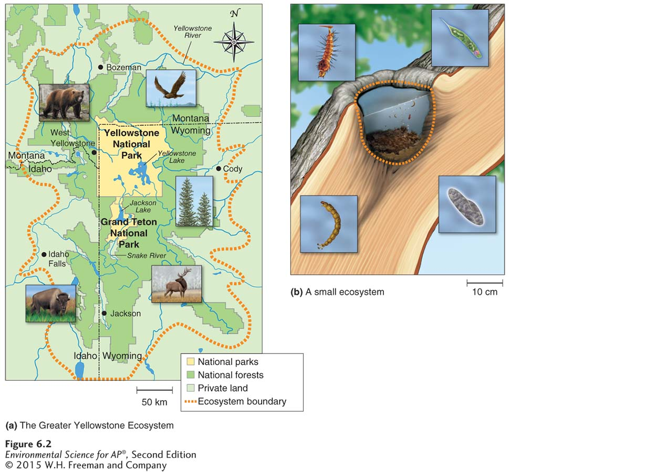
Ecosystem Boundaries
Large and small ecosystems. (a) The Greater Yellowstone Ecosystem includes the land within Yellowstone National Park and many adjacent properties. (b) Some ecosystems are very small, such as a rain-filled tree hole that houses a diversity of microbes and aquatic insects.

Slide 5
Photosynthesis captures energy and respiration releases energy
Producer An organism that uses the energy of the Sun to produce usable forms of energy. Also known as Autotroph.
Photosynthesis The process by which producers use solar energy to convert carbon dioxide and water into glucose.
Cellular respiration The process by which cells unlock the energy of chemical compounds.
Aerobic respiration The process by which cells convert glucose and oxygen into energy, carbon dioxide, and water.
Anaerobic respiration The process by which cells convert glucose into energy in the absence of oxygen.

Slide 6
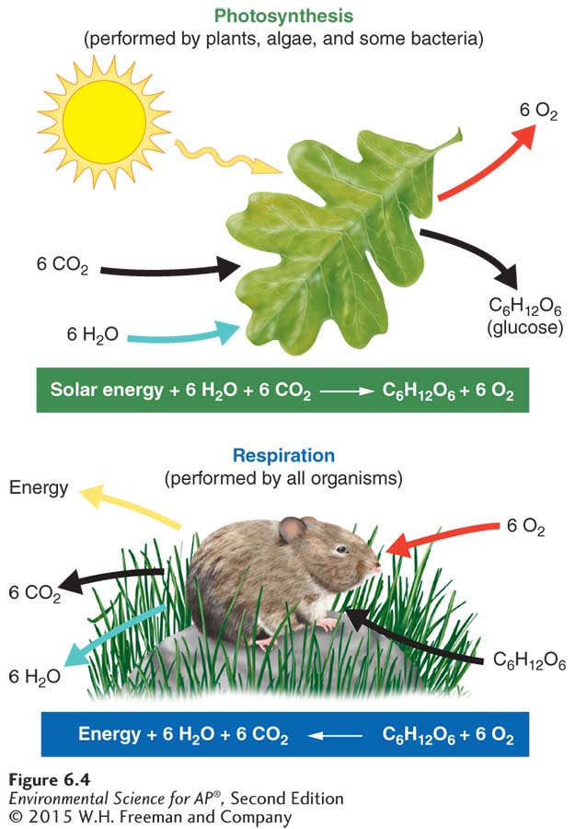
Photosynthesis and Respiration
Photosynthesis and respiration. Photosynthesis is the process by which producers use solar energy to convert carbon dioxide and water into glucose and oxygen. Respiration is the process by which organisms convert glucose and oxygen into water and carbon dioxide, releasing the energy needed to live, grow, and reproduce. All organisms, including producers, perform respiration.

Slide 7
Energy captured by producers moves through many trophic levels
Consumer An organism that is incapable of photosynthesis and must obtain its energy by consuming other organisms. Also known as Heterotroph.
Herbivore A consumer that eats producers. Also known as Primary consumer.
Carnivore A consumer that eats other consumers.
Secondary consumer A carnivore that eats primary consumers.
Tertiary consumer A carnivore that eats secondary consumers.
Trophic levels The successive levels of organisms consuming one another.
Food chain The sequence of consumption from producers through tertiary consumers.

Slide 8
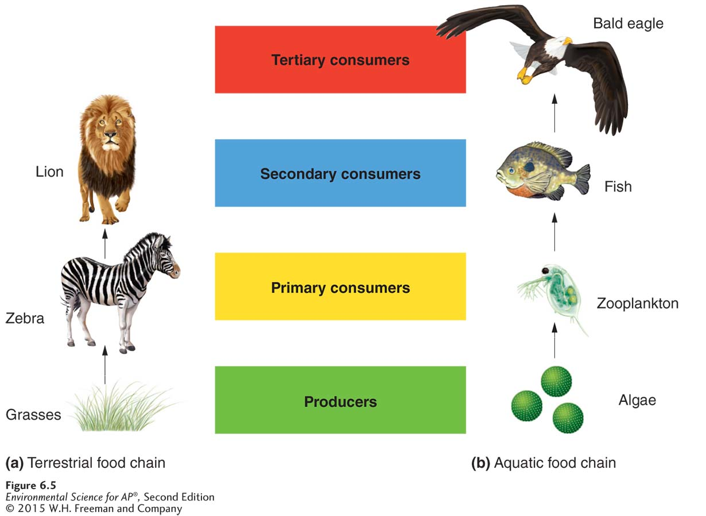
Trophic Levels
Simple food chains. A simple food chain that links producers and consumers in a linear fashion illustrates how energy and matter move through the trophic levels of an ecosystem. (a) An example of a terrestrial food chain. (b) An example of an aquatic food chain.

Slide 9
Trophic levels
Food web A complex model of how energy and matter move between trophic levels.
Scavenger An organism that consumes dead animals.
Detritivore An organism that specializes in breaking down dead tissues and waste products into smaller particles.
Decomposers Fungi and bacteria that convert organic matter into small elements and molecules that can be recycled back into the ecosystem.

Slide 10
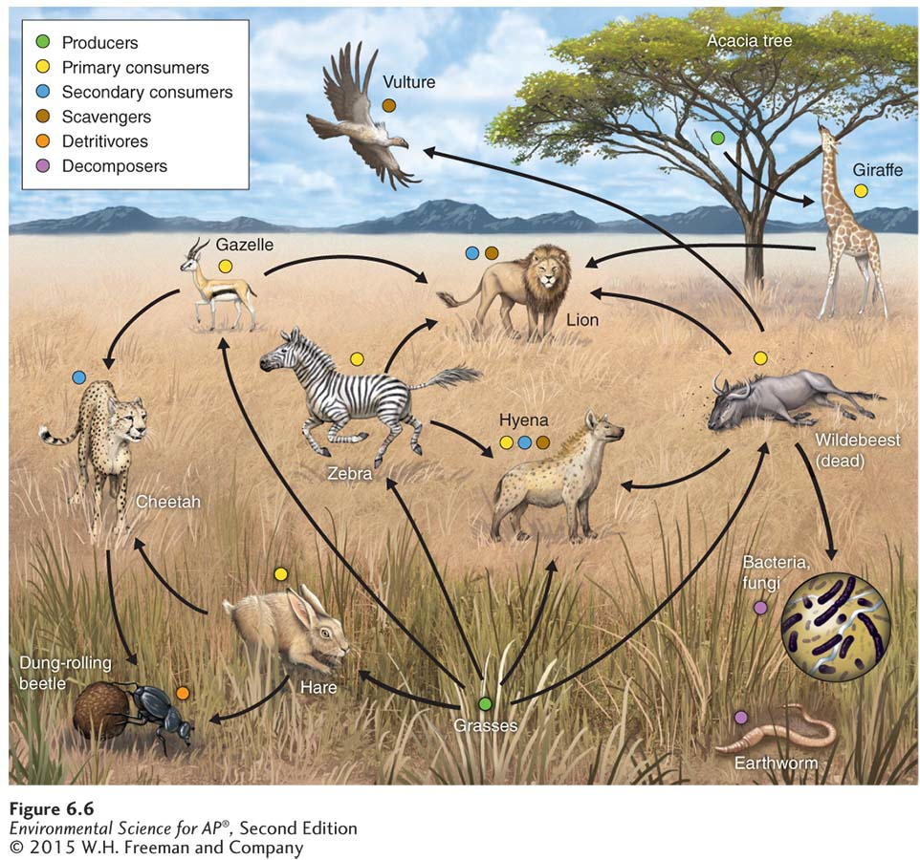
Trophic Levels
A simplified food web. Food webs are more realistic representations of trophic relationships than simple food chains. They include scavengers, detritivores, and decomposers, and they recognize that some species feed at multiple trophic levels. Arrows indicate the direction of energy movement. This is a real but somewhat simplified food web; in an actual ecosystem, many more organisms are present. In addition, there are many more energy movements.

Slide 11
Some ecosystems are more productive than others
Gross primary productivity (GPP) The total amount of solar energy that producers in an ecosystem capture via photosynthesis over a given amount of time.
Net primary productivity (NPP) The energy captured by producers in an ecosystem minus the energy producers respire.

Slide 12
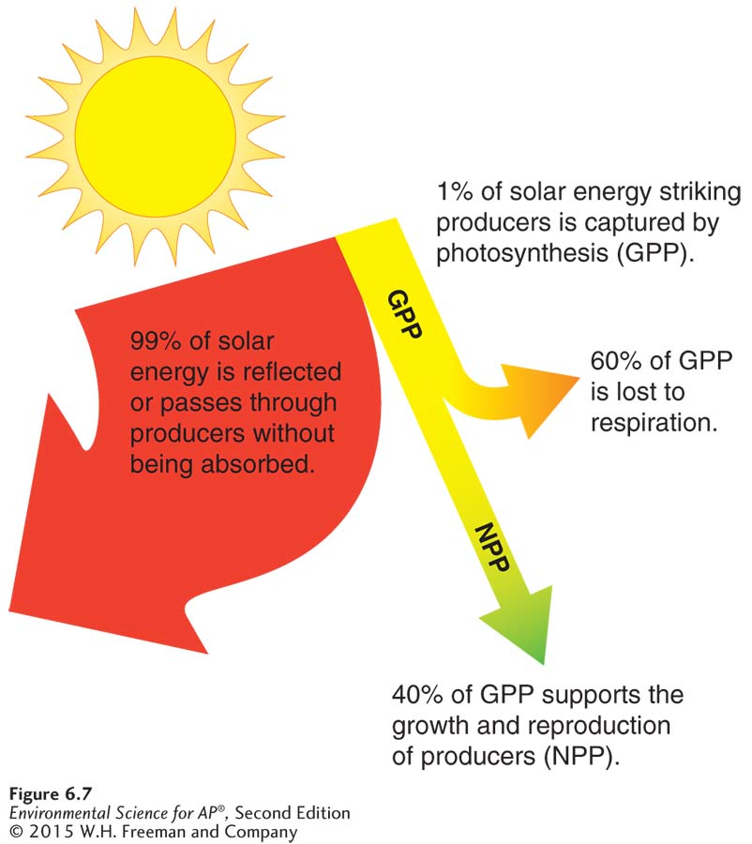
Ecosystem Productivity
Gross and net primary productivity. Producers
typically capture only about 1 percent of available solar energy via photosynthesis. This is known as gross primary productivity, or GPP. About 60 percent of GPP is typically used for respiration. The remaining 40 percent of GPP is used for the growth and reproduction of the producers. This is known as net primary productivity, or NPP.

Slide 13
The efficiency of energy transfer affects the energy present in each trophic level
Biomass The total mass of all living matter in a specific area.
Standing crop The amount of biomass present in an ecosystem at a particular time.
Ecological efficiency The proportion of consumed energy that can be passed from one trophic level to another.
Trophic pyramid A representation of the distribution of biomass, numbers, or energy among trophic levels.

Slide 14
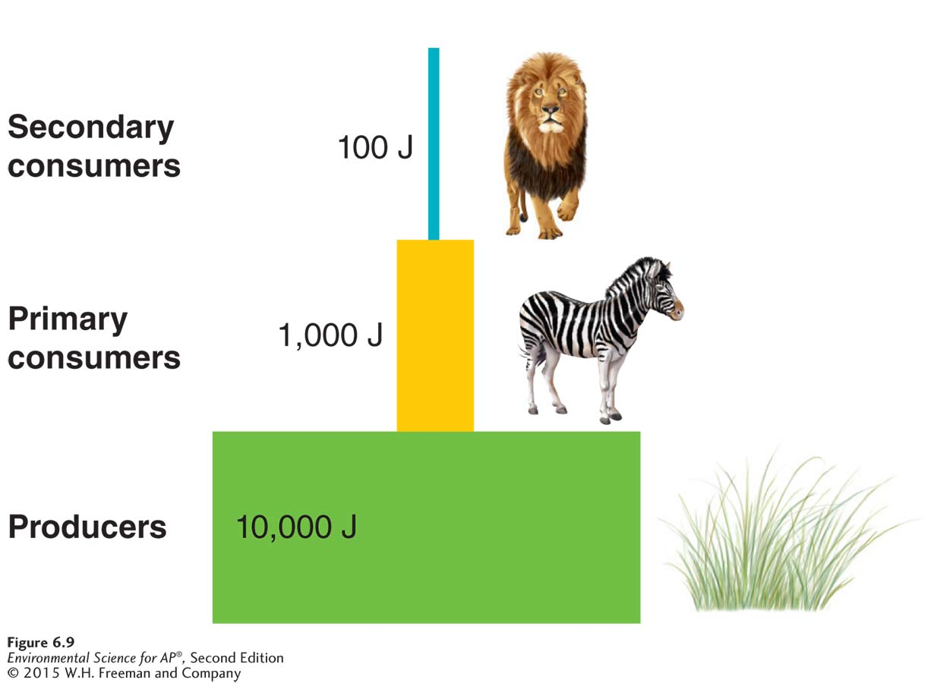
Ecosystem Efficiency
Trophic pyramid for the Serengeti ecosystem. The amount of energy that is present at each trophic level is shown in joules (J). The pyramid assumes 10 percent ecological efficiency, but efficiencies can range from 5 to 20 percent across different ecosystems. For most ecosystems, graphing the numbers of individuals or biomass within each trophic level would produce a similar pyramid.

Slide 15
Module 7 The Movement of Matter
After reading this module you should be able to
describe how water cycles within ecosystems.
explain how carbon cycles within ecosystems.
describe how nitrogen cycles within ecosystems.
explain how phosphorus cycles within ecosystems.
discuss the movement of calcium, magnesium, potassium, and sulfur within ecosystems.

Slide 16
The hydrologic cycle moves water through the biosphere
Biogeochemical cycle The movements of matter within and between ecosystems.
Hydrologic cycle The movement of water through the biosphere.

Slide 17
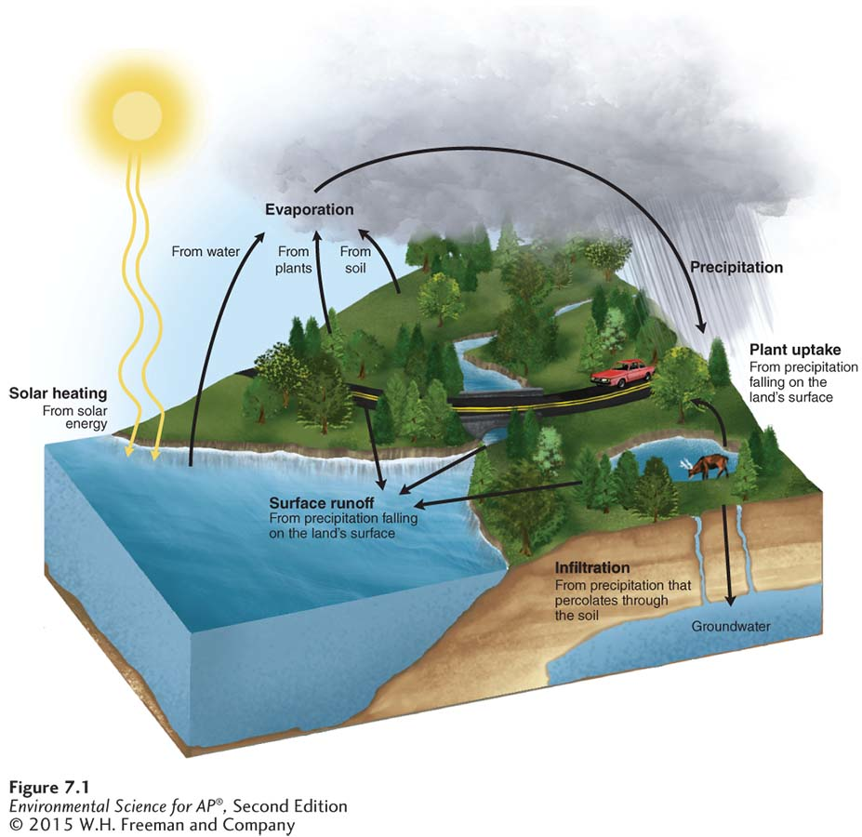
The Hydrologic Cycle
The hydrologic cycle. Water moves from the atmosphere to Earth’s surface and back to the atmosphere.

Slide 18
The Hydrologic Cycle
Transpiration The release of water from leaves during photosynthesis.
Evapotranspiration The combined amount of evaporation and transpiration.
Runoff Water that moves across the land surface and into streams and rivers.

Slide 19
The carbon cycle moves water between air, water, and land
Carbon cycle The movement of carbon around the biosphere.

Slide 20
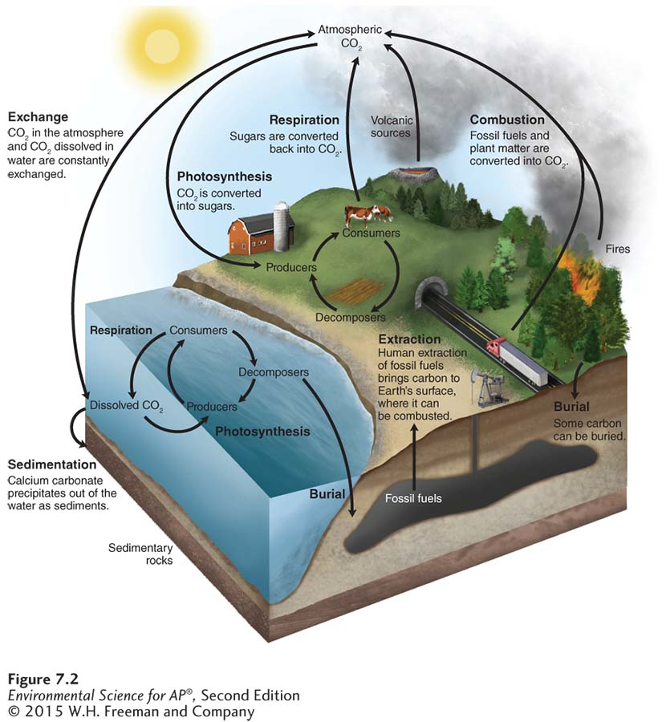
The Carbon Cycle
The carbon cycle. Producers take up carbon from the atmosphere via photosynthesis and pass it on to consumers and decomposers. Some inorganic carbon sediments out of the water to form sedimentary rock while some organic carbon may be buried and become fossil fuels. Respiration by organisms
returns carbon to the atmosphere and water. Combustion of fossil fuels and other organic matter returns carbon to the atmosphere.

Slide 21
The nitrogen cycle includes many chemical transformations
Macronutrient One of six key elements that organisms need in relatively large amounts: nitrogen, phosphorus, potassium, calcium, magnesium, and sulfur.
Limiting nutrient A nutrient required for the growth of an organism but available in a lower quantity than other nutrients.
Nitrogen cycle The movement of nitrogen around the biosphere.

Slide 22
The Nitrogen Cycle
Nitrogen fixation A process by which some organisms can convert nitrogen gas molecules directly into ammonia.
Nitrification The conversion of ammonia (NH₄⁺) into nitrite (NO₂– ) and then into nitrate (NO₃– ).
Assimilation The process by which producers incorporate elements into their tissues.

Slide 23
The Nitrogen Cycle
Mineralization The process by which fungal and bacterial decomposers break down the organic matter found in dead bodies and waste products and convert it into inorganic compounds.
Ammonification The process by which fungal and bacterial decomposers break down the organic nitrogen found in dead bodies and waste products and convert it into inorganic ammonium (NH₄⁺).
Denitrification The conversion of nitrate (NO₃– ) in a series of steps into the gases nitrous oxide (N₂O) and, eventually, nitrogen gas (N2), which is emitted into the atmosphere.
Leaching The transportation of dissolved molecules through the soil via groundwater.
Notes:
Title OK?

Slide 24
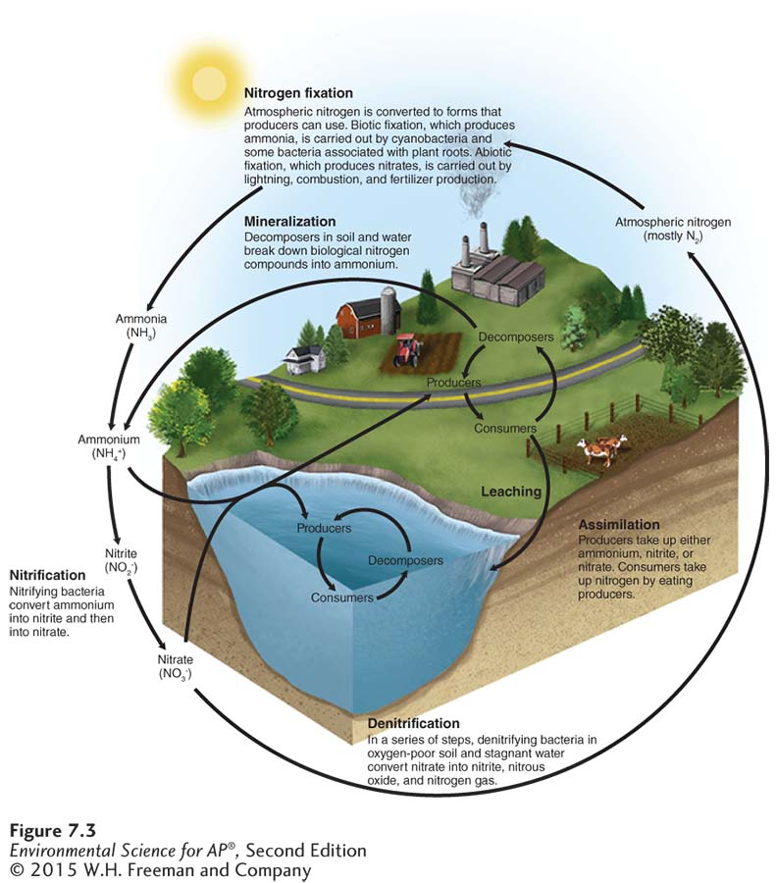
The Nitrogen Cycle
The nitrogen cycle. The nitrogen cycle moves nitrogen from the atmosphere and into soils
through several fixation pathways, including the production of fertilizers by humans. In the soil, nitrogen can exist in several forms. Denitrifying bacteria release nitrogen gas back into the atmosphere.

Slide 25
The phosphorus cycle moves between land and water
Phosphorus cycle The movement of phosphorus around the biosphere.
Algal bloom A rapid increase in the algal population of a waterway.
Hypoxic Low in oxygen.

Slide 26
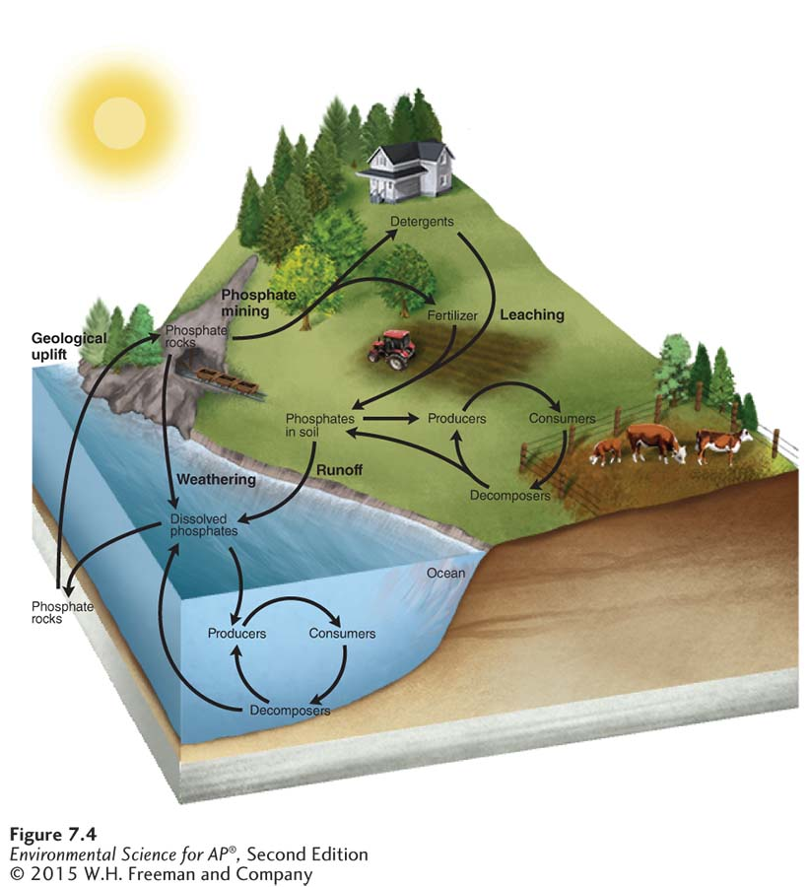
The Phosphorus Cycle
The phosphorus cycle. The phosphorus cycle begins with the weathering or mining of phosphate rocks and use of phosphate fertilizer, which releases phosphorus into the soil
and water. This phosphorus can be used by producers and subsequently moves through the food web. In water, phosphorus can precipitate out of solution and form sediments, which over time are transformed into new phosphate rocks.

Slide 27
Calcium, magnesium, potassium, and sulfur also cycle in ecosystems
Sulfur cycle The movement of sulfur around the biosphere.

Slide 28
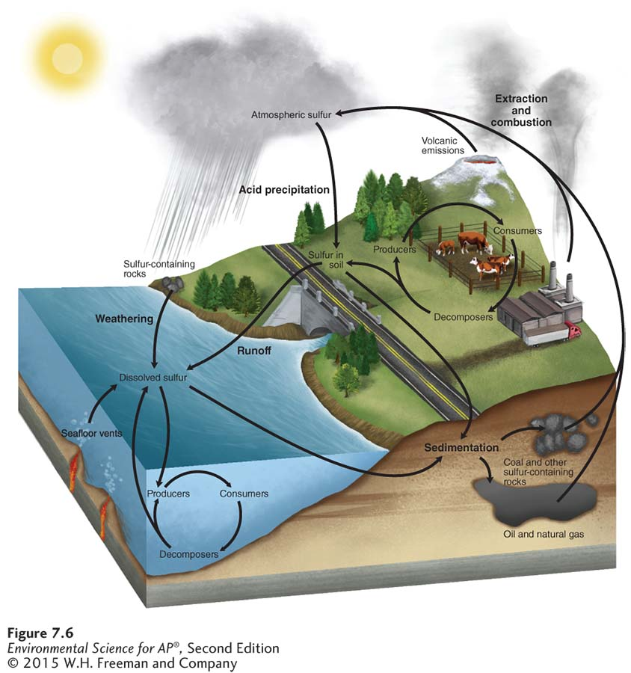
The Sulfur Cycle
The sulfur cycle. Most sulfur exists as rocks. As these rocks are weathered over time, they release sulfate ions (SO₄²⁻ ) that producers can take up and assimilate. This assimilated sulfur then passes through the food web. Volcanoes, the burning of fossil fuels, and the mining of copper put sulfur dioxide (SO₂) into the atmosphere. In the atmosphere, sulfur dioxide combines with water to form sulfuric acid (H₂SO₄). This
sulfuric acid is carried back to Earth when it rains or snows.

Slide 29
Module 8 Responses to Disturbances
After reading this module you should be able to
distinguish between ecosystem resistance and ecosystem resilience.
explain the insights gained from watershed studies.
explain the intermediate disturbance hypothesis.

Slide 30
Ecosystems are affected differently by disturbance and in how well they bounce back after the disturbance
Disturbance An event, caused by physical, chemical, or biological agents, resulting in changes in population size or community composition.
Resistance A measure of how much a disturbance can affect flows of energy and matter in an ecosystem.
Resilience The rate at which an ecosystem returns to its original state after a disturbance.
Restoration ecology The study and implementation of restoring damaged ecosystems.

Slide 31
Watershed studies help us understand how disturbances affect ecosystem processes
Watershed All land in a given landscape that drains into a particular stream, river, lake, or wetland.

Slide 32
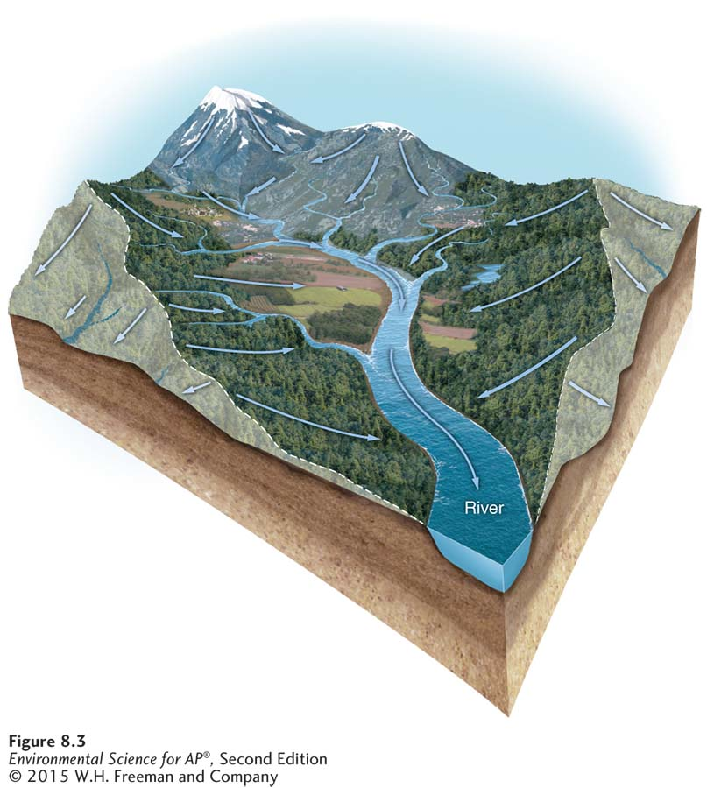
Watershed Studies
Watershed. A watershed is the area of land that drains into a particular body of water.

Slide 33
Intermediate levels of disturbance favor high species diversity
Intermediate disturbance hypothesis The hypothesis that ecosystems experiencing intermediate levels of disturbance are more diverse than those with high or low disturbance levels.

Slide 34
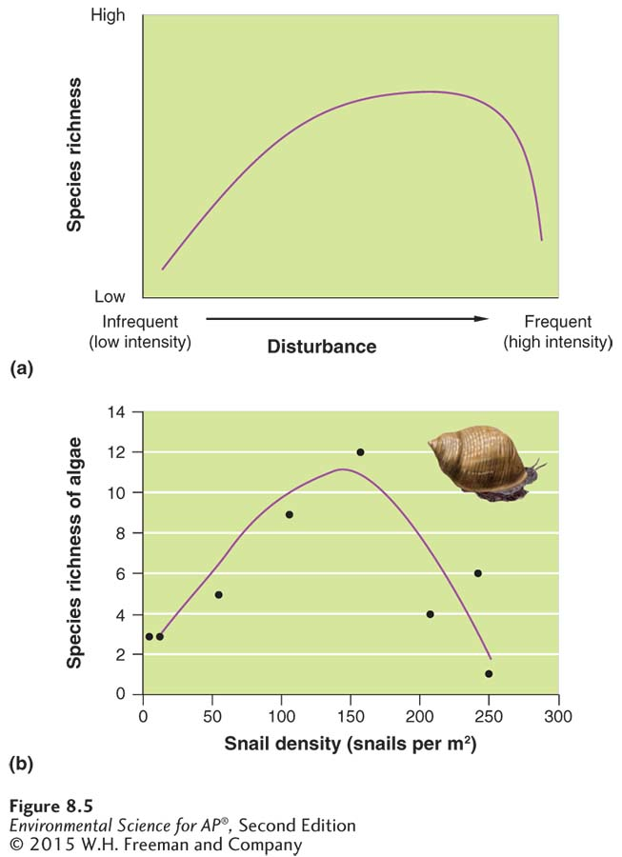
Intermediate disturbance
hypothesis. (a) In general, we expect to see the highest species diversity at intermediate levels
of disturbance. Rare disturbances favor the best competitors, which outcompete other species. Frequent disturbances eliminate most species except those that have evolved to live under such conditions. At intermediate levels of disturbance, species from
both extremes can persist. (b) An example of the intermediate disturbance in the number of algal
species observed in response to different amounts of herbivory by marine snails. When few or many
snails are present, there is a low diversity of algal species, but when an intermediate density of snails are consuming algae, the snails cause an intermediate
amount of disturbance and a higher diversity of algal species can persist in the ecosystem.

